Slide 1
Advanced Placement (AP) Trends in Ohio
College Board presentation to the Senate Committee on Finance - Education Subcommittee: 5/7/15

Slide 2
About the College Board
Founded in 1900, the College Board was created to expand access to higher education.
Today, we are a mission-driven, not-for-profit membership organization made up of over 6,000 of the world’s leading colleges, schools, and other educational organizations.
Through our programs and initiatives we challenge all students to own their future by practicing hard and taking advantage of every opportunity they earn.
2

Slide 3
About the Advanced Placement (AP) Program
Since 1955, the College Board’s AP Program – the collaborative community of AP teachers and students, states, districts, schools, colleges, and universities — has been delivering excellence in education to millions of students across the country.
AP enables willing and academically prepared students to pursue college-level studies — with the opportunity to earn college credit, advanced placement, or both — while still in high school.
Students who score a 3 or higher on AP Exams are more likely to graduate college on time and they have the potential to save time and money through placement and credit-granting policies.
  New research shows even students who score 1s and 2s on exams are more likely to graduate from college on time.

Slide 4
How Does AP Happen?
The collaboration between college faculty and AP teachers lies at the core of AP, ensuring depth and fairness. These groups work together to develop, deliver, and evaluate AP.
They collaborate to validate each teacher’s individual syllabus — ensuring that teachers fully understand the elements required for an AP course to be considered college level.
Through high-quality professional development and active teacher participation in the online AP Teacher Community, successful strategies are shared beyond individual classrooms.
Finally, these groups come together to evaluate actual student work — allowing themselves to be invested in this process from the beginning to the end.

Slide 5
Advanced Placement Courses and Exams
Offering 36 subjects, AP courses and exams include:
Arts:
Art History,
Music Theory,
Studio Art: 2-D Design,
Studio Art: 3-D Design,
Studio Art: Drawing
English:
English Language and Composition,
English Literature and Composition
Math & Computer Science:
Calculus AB,
Calculus BC,
Computer Science A,
Statistics
History & Social Science:
Comparative Government and Politics,
European History,
Human Geography, Macroeconomics, Microeconomics,
Psychology,
US Government and Politics,
United States History,
World History
Sciences:
Biology,
Chemistry,
Environmental Science,
Physics C: Electricity and Magnetism,
Physics C: Mechanics,
Physics 1: Algebra-Based,
Physics 2: Algebra-Based
World Languages & Cultures:
Chinese Language and Culture,
French Language and Culture,
German Language and Culture,
Italian Language and Culture,
Japanese Language and Culture,
Latin,
Spanish Language and Culture,
Spanish Literature and Culture
AP Capstone
AP Seminar

Slide 6
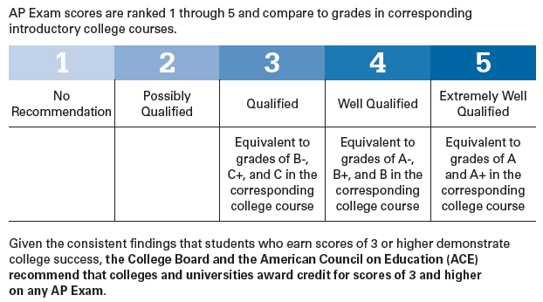
Scoring Scale for AP Exams

Slide 7
Why Do Students Take AP Courses and Exams?
Stand Out in College Admissions
  When admissions officers see “AP” on a transcript, they know that the student experienced the most rigorous classes their high school has to offer and is ready for the challenges of college.
Earn College Credits
  By taking an AP course and scoring successfully on the related AP Exam, a student can save on college expenses: most colleges and universities nationwide offer college credit, advanced placement, or both, for qualifying AP Exam scores. (see OH policy)
Build College Skills
  Taking an AP course builds the skills a student needs throughout their college years. It gives a student’s mind a rigorous workout while polishing up their time management and study skills.

Slide 8
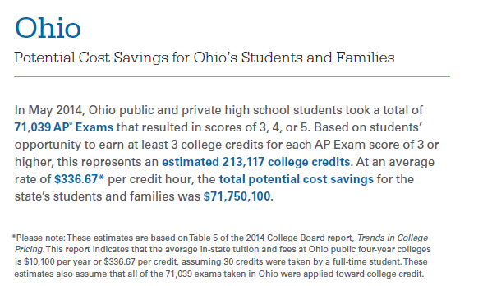
Potential Cost Savings for Ohio Students and Families

Slide 9
Ohio’s Statewide AP Credit-by-Exam Policy
“Beginning in 2009, students in Ohio who take a College Board Advanced Placement examination and score at least a '3' are guaranteed college credit, usually towards their general education curriculum, upon entering an Ohio Public Institution of Higher Education.”
Is the policy good for students and universities?
  According to the 4-year study by the Ohio Board of Regents – Yes
    Their summary findings and those of other states that completed similar validation studies of this standard AP Credit-by-Exam policy are found on the next slide.
The full policy may be seen here: https://www.ohiohighered.org/transfer/advancedplacement

Slide 10
Validation Studies of AP Credit-by-Exam Policies
The Ohio Board of Regents (2013)
  The Ohio study found that “the AP policy is beneficial for Ohio.”
    “Learning outcomes associated with AP test-scores of 3, 4, 5, are equivalent to learning outcomes associated with corresponding college courses.” Students earning scores of 3 or higher on AP exams “have an opportunity for saving resources, both time and money, but without compromising academic standards.”
Florida Department of Education, Office of Articulation (2012)
  The Florida study found that “no changes are needed to the AP portion of the Credit-by-Exam Equivalencies.”
    “AP student grade point averages in subsequent coursework are generally higher than the grade point averages of students who complete the equivalent course in class, and then complete the subsequent course.”
University of Wisconsin - Madison (2009)
  The Wisconsin study, found that “students who came with a 3, 4, or 5 on the (AP) exams were doing as well or better than those taking our classes and exams.”
    Study was conducted by UW-Madison administrative officials to “demystify some of the things (they) were hearing from faculty members” concerning the AP credit policy.

Slide 11
Other Research on AP’s Effectiveness
Research consistently shows that when compared to their matched peers, students who score a 3 or higher on an AP Exam typically:
Earn higher GPAs in college
Perform as well as or better in subsequent college courses in the exam subject than non-AP students who took the corresponding introductory college course
Take more — not less — college course work in the discipline
Are more likely to graduate college on time (in four years)
Have higher graduation rates
New research shows that taking an AP Exam, even for students who score a 1 or 2, increases the expected on-time college graduation rate for students when compared to academically matched peers who did not take an AP Exam (Mattern, Marini, & Shaw, 2014).

Slide 12
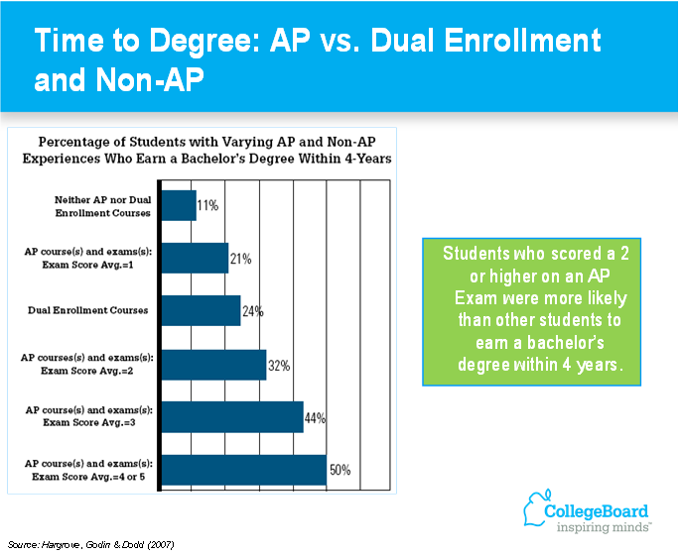
Time to Degree: AP vs Dual Credit
Notes:
Linda Hargrove, Donn Godin, & Barbara Dodd. (2008). College Outcomes Comparisons by AP and Non-AP High School Experiences. New York: College Board Research Report No. 2008-3.
Leslie Keng & Barbara Dodd. (2008). A Comparison of College Performance of AP and Non-AP Student Groups in 10 Subject Areas. New York: College Board Research Report No. 2008-7.

Slide 13
AP students have higher average college GPAs than dual enrollment students.
Notes:
Linda Hargrove, Donn Godin, & Barbara Dodd. (2008). College Outcomes Comparisons by AP and Non-AP High School Experiences. New York: College Board Research Report No. 2008-3.
Leslie Keng & Barbara Dodd. (2008). A Comparison of College Performance of AP and Non-AP Student Groups in 10 Subject Areas. New York: College Board Research Report No. 2008-7.

Slide 14
Ohio Board of Regents research on AP vs. non-AP
Academic Outcomes of 4-Year University Freshman Cohorts:
A Comparison of Dual Enrollees & Advanced Placement (AP) Credit Recipients
Findings:
Students with AP credit and those with both AP and dual enrollment credit achieve the highest average outcomes.
  AP: GPA (3.24), attempted hours (32.1), completion rate (94.4%).
  DE: GPA (2.75), attempted hours (29.1), completion rate (84.8%).
  Both: GPA (3.38), attempted hours (32.3), completion rate (94.5%).
  Others: GPA (2.42), attempted hours (27.7), completion rate (79.0%).
Time trend: The averages are stable over time as well.

Slide 15
Advanced Placement (AP) Trends in Ohio
2004 to 2014 – Comparative Look

Slide 16
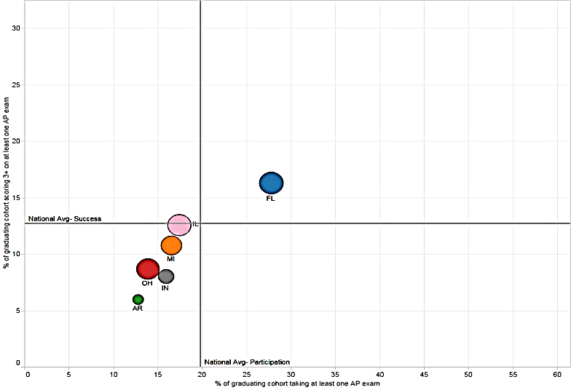
Ohio AP Trends: 2004 Graduating Cohort Results

Slide 17
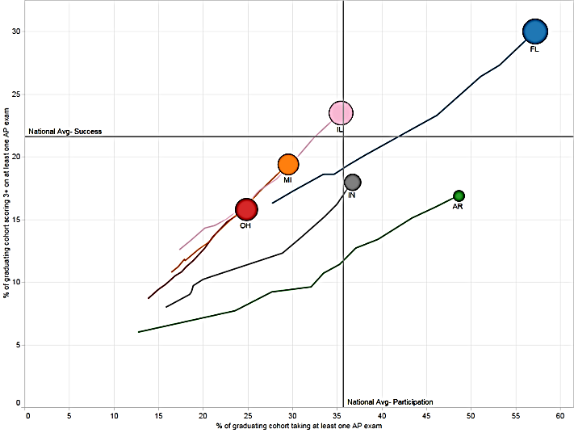
Ohio AP Trends: 2014 Graduating Cohort Results

Slide 18
Current AP policies in Ohio
Ohio has current policies that support student pursuit of AP excellence such as:
  the statewide Credit-by-Exam policy that guarantees a student college credit at any state public university when he/she scores a 3 or higher on an exam, and
  the new graduation requirements which allow students to take AP Government, U.S. History, Physics and Biology as substitute End-of-Course exams allowing students the possibility to earn both high school and college credit for the same test.
These are great policies but currently far too many students will not be able to take advantage of these policy benefits due to having little or no AP courses offered at their school.

Slide 19
Three-Pronged Approach to Increase AP Success
The House “as passed version” of the biennial budget (HB64) has provisions in it that will promote greater access and success to districts throughout the state. This will help restore Ohio’s competiveness with its neighboring states.
There are 141 districts (23% of state total) that have no student AP success - meaning they have no AP exam scores of three (3) or higher on any of the 36 tests.
There are an additional 76 districts that have less than 10% of students taking an AP exam while in high school. The national average is 22%.
The grant programs recommended herein are being effectively used in neighboring states to dramatically improve AP student success in districts with little or no previous success.

Slide 20
Start-Up & Ramp-Up competitive grants for districts
Tier 1 Start-Up Grants
Eligible grants recipients for Tier 1 shall be districts with a zero percent AP student successful completion rate.
  Ohio has 141 districts that would compete for grants that would allow them to get AP programs off the ground - initiating one to three AP courses built for student success.
Tier 2 Ramp-Up Grants
Eligible grants recipients for Tier 2 shall be districts with a greater than zero percent but less than ten percent AP student successful completion rate.
  Ohio has 76 districts that would compete for grants that would allow them to create additional AP courses built for student success.

Slide 21
Rewards for Top AP Performers by District Typology
The top three districts statewide with the highest AP successful completion rate, regardless of typology win bonus monies in FY17.
The top two districts statewide within each typology (urban, suburban, small town and rural) with the highest AP successful complete rate each win bonus monies in FY17.
“Successful completion rate” is the percent of a school district’s students in grade eleven and twelve who scored a three or better on an AP exam.
  This unduplicated measure is a great way to simultaneously incent greater participation and success. A school’s “successful complete rate” only increases if additional students take and pass AP exams.

Slide 22
Advanced Placement (AP) Trends in Ohio
College Board presentation to the Senate Committee on Finance - Education Subcommittee: 5/7/15

