Slide 1

Health Transformation
Budget Priorities
Senate Finance Committee Testimony
April 21, 2015
www.HealthTransformation.Ohio.gov

Slide 2

Ohio’s Health Transformation Team
John McCarthy, Medicaid
Bonnie Burman, Aging
Kevin Miller, Opportunities for Ohioans with Disabilities
John Martin, Developmental Disabilities
Tracy Plouck, Mental Health and Addiction Services
Rick Hodges, Health
Cynthia Dungey, Job and Family Services
Greg Moody, Office of Health Transformation

Slide 3
Today’s Topics
Overall Budget Impact
Prioritize Home and Community Based Services
Rebuild Community Behavioral Health System Capacity
Enhance Community Developmental Disabilities Services
Reduce Infant Mortality and Tobacco Use
Modernize Medicaid Provider Payments
Move Ohioans Up and Out of Poverty

Slide 4
2011 Ohio Crisis vs. Results Today
$8 billion state budget shortfall 89-cents in the rainy day fund Nearly dead last (48th) in job creation (2007-2009) Medicaid spending increased 9% annually (2009-2011) Medicaid over-spending required multiple budget corrections Ohio Medicaid stuck in the past and in need of reform More than 1.5 million uninsured Ohioans (75% of them working)
Notes:
We went from this …
[CLICK]
… to this:
A balanced budget with $1.5 billion in the rainy day fund – and that, by the way, while reducing income taxes, cutting taxes on small businesses in half, and eliminating Ohio’s estate tax.
Today Ohio ranks first in the Midwest and 5th in the nation in job creation.
We held Medicaid spending to 3 percent annually and closed our last Medicaid budget $950 million in the black.
From this position of strength, we were able to extend Medicaid coverage without breaking the bank.
Since October, nearly 200,000 uninsured Ohioans have received coverage as a result of our decision to expand Medicaid.

Slide 5
2011 Ohio Crisis vs. Results Today
$8 billion state budget shortfall 89-cents in the rainy day fund Nearly dead last (48th) in job creation (2007-2009) Medicaid spending increased 9% annually (2009-2011) Medicaid over-spending required multiple budget corrections Ohio Medicaid stuck in the past and in need of reform More than 1.5 million uninsured Ohioans (75% of them working) | Balanced budget $1.5 billion in the rainy day fund One of the top ten job creating states in the nation Medicaid increased 4.1% in 2012 and 2.5% in 2013 (pre-expansion) Medicaid budget under-spending was $1.9 billion (2012-2013) and $2.5 billion (2014-2015) Ohio Medicaid embraces reform Extended Medicaid coverage
Notes:
We went from this …
[CLICK]
… to this:
A balanced budget with $1.5 billion in the rainy day fund – and that, by the way, while reducing income taxes, cutting taxes on small businesses in half, and eliminating Ohio’s estate tax.
Today Ohio ranks first in the Midwest and 5th in the nation in job creation.
We held Medicaid spending to 3 percent annually and closed our last Medicaid budget $950 million in the black.
From this position of strength, we were able to extend Medicaid coverage without breaking the bank.
Since October, nearly 200,000 uninsured Ohioans have received coverage as a result of our decision to expand Medicaid.

Slide 6
As Introduced
Ohio Medicaid GRF State Share
(in billions)
Source: Ohio Department of Medicaid (February 2015).

Slide 7
As Introduced
Ohio Medicaid Spending (GRF State Share)
Source: Ohio Department of Medicaid, Overall Budget Impact (January 2015).

Slide 8
As Introduced
Ohio Medicaid Spending (All Funds)
The House reduces PMPM estimates ($594 million over two years)
Reduces the Medicaid Reserve Fund ($230 million)
Reduces funding for Medicaid administration
Source: Ohio Department of Medicaid, Overall Budget Impact (January 2015).

Slide 9
As Introduced
Ohio Medicaid Annual Growth Projections
(calculated on a Per Member Per Month basis)
State Fiscal Year | JMOC Upper Bound | Medical CPI | JMOC Target | Executive Budget
 |  |  |  | (All Agencies) | (Excluding DD)
2016 | 2.90% | 3.30% | 2.90% | 1.38% | 0.75%
2017 | 4.50% | 3.30% | 3.30% | 4.50% | 4.05%
Avg. | 3.70% | 3.30% | 3.10% | 2.94% | 2.40%
Source: Ohio Department of Medicaid, Overall Budget Impact (January 2015).

Slide 10
Today’s Topics
Overall Budget Impact
Prioritize Home and Community Based Services
Rebuild Community Behavioral Health System Capacity
Enhance Community Developmental Disabilities Services
Reduce Infant Mortality and Tobacco Use
Modernize Medicaid Provider Payments
Move Ohioans Up and Out of Poverty

Slide 11
Prioritize Home and Community Services
First Four Years
Increased home and community based services (HCBS) waiver alternatives to nursing homes and other institutions
Now spend more on HCBS than institutions
Goal is to enable seniors and people with disabilities to live with dignity in the setting they prefer, especially their own home
Blueprint for a New Ohio
Increases the investment in HCBS waiver programs
Creates new opportunities for individuals to self-direct care
Implements “no wrong door” entry into long term care
Creates a process to comply with new federal HCBS regulations
Improves quality in facility-based and community-based care
Source: Office of Health Transformation, Prioritize Home and Community Based Services (February 2015).

Slide 12
Ohio Medicaid Residents of Institutions Compared to Recipients of Home and Community Based Services
Home and Community Based
(Aging, Medicaid, and DD waiver enrollment)
64%
36%
42%
Facility-Based
(Nursing Facilities, ICF-IID and Developmental Center residents)
Source: Office of Health Transformation, Prioritize Home and Community Based Services (February 2015).

Slide 13
Simplify Disability Determination
Background
50,000 Ohioans with a disability qualify for Medicaid each year
They have to prove they are disabled twice – via county JFS offices for Medicaid, and separately via Opportunities for Ohioans with Disabilities (OOD) to qualify for Supplemental Security Income (SSI)
Most states (33) have already eliminated this duplication and automatically enroll SSI individuals in Medicaid
Blueprint for a New Ohio
Replaces Ohio’s two disability determination systems with one
Eliminates “Spend Down” and establishes “Miller Trusts”
No change in enrollment for most (403,000) current beneficiaries, some “woodwork” (9,500-14,500) will now enroll in Medicaid, and some (up to 22,000) will receive federal exchange subsidies
For more detail: Simplify Eligibility Determination (updated April 2015).

Slide 14
Improve Quality in Home Health Care
77,561 Ohioans receive in-home services provided by direct care workers.
65,254 (84%) rely on home care agencies only
8,346 (11%) rely on independent non-agency providers only
3,961 (5%) rely on both
Agency Only
84%
5% Both
Source: Ohio Department of Medicaid (SFY 2014).
Notes:
The economics are simple: we get what we pay for.
Our nation’s predominantly fee-for-service system financially rewards more volume and fragmentation with no assurance of quality. This is so bizarre that in some cases – avoidable hospital admissions are a good example – we actually pay a higher price for lower quality.
The financial incentive is upside down and its killing us:
the US pays twice as much per person to rank last among 11 industrial nations related to deaths that are preventable with timely and effective care.
We pay twice as much to have more infant deaths.
That is a jarring contradiction, and we have to sort this out.

Slide 15
Improve Quality in Home Health Care
Blueprint for a New Ohio
Provides 10,000 more Ohioans a choice to live at home or in another community setting instead of receiving facility-based care
Clarifies that Ohio Medicaid has the authority to guarantee that individuals have the right to self-direct HCBS waiver services
Clarifies that the employer for a direct support worker must be either an individual who self-directs their support or an agency, not the State of Ohio
Allows the Administration to restart implementation of a direct care worker certification program
In addition, the Administration welcomes clarifying language to address stakeholder concerns about process and timing
The House eliminates language related
to self-direction
Eliminates language that clarifies direct care workers are not state employees
Does not address concerns from House testimony about process and timing
Requires agency nursing waiver rates to be 10% higher than independent rates
Source: Office of Health Transformation, Reform Home Care Payments (February 2015).

Slide 16
Improve Quality in Nursing Facilities
First Four Years
Completed the conversion to a price-based payment system
Linked nursing facility reimbursement to quality outcomes
Reduced rates 6 percent in 2012 then held flat
Blueprint for a New Ohio (invests $61 million over two years)
Increases NF reimbursement $84 million in 2017 by rebasing the formula (+$154 million) and updating the “grouper” (-$70 million)
Links 100 percent of the increase to quality performance
Reduces reimbursement for low acuity individuals (-$24 million)
Removes the NF rate formula from statute
The House increases NF reimbursement ($56 million over two years)
Recycles unspent quality funds to the highest rated facilities
Continues institutional bias in statute
Source: Office of Health Transformation, Reform Nursing Facility Payments (February 2015).

Slide 17
Today’s Topics
Overall Budget Impact
Prioritize Home and Community Based Services
Rebuild Community Behavioral Health System Capacity
Enhance Community Developmental Disabilities Services
Reduce Infant Mortality and Tobacco Use
Modernize Medicaid Provider Payments
Move Ohioans Up and Out of Poverty

Slide 18
Ohio Behavioral Health Spending
Total MHAS and Medicaid Behavioral Health Spending (Federal and State Funds in millions)
Jobs Budget Jobs Budget 2.0
Ohio Department of Medicaid
Ohio Department of Mental Health and Addiction Services
Source: Office of Health Transformation, Rebuild Community Behavioral Health System Capacity (February 2015).

Slide 19
Modernize Medicaid Behavioral Health
Background
The mental health and addiction services system was in turmoil
20 percent cut in state funds over previous four years (2007-2010)
First Four Years
Increased state support for mental health and addiction services
Freed local boards from Medicaid match responsibilities
Extended coverage to more Ohioans seeking recovery
Blueprint for a New Ohio
Recodes the Medicaid behavioral health benefit to align with commercial health insurance
Moves Medicaid behavioral health benefits into managed care to better integrate physical and behavioral health care
The House excludes Medicaid managed care for behavioral health
Source: Office of Health Transformation, Rebuild Community Behavioral Health System Capacity (February 2015).

Slide 20
Distribution of Behavioral Health Clients by Spending
Millions of dollars
100 percent = $1.2 million
Top 5 percent account for 52 percent of spending…
Each bar represents:
5 percent of clients
≈30,000
5% least costly clients 5% most costly clients
Source: Ohio Medicaid claims, including claims with diagnosis code of ICD9 290-314 excluding 299 and dementia codes in 294; does not include pharmacy claims (August 2012-July 2013).

Slide 21
Rebuild Community Behavioral Health
Blueprint for a New Ohio
Preserves hospital capacity for individuals in crisis
Partners with DRC to invest in more addiction treatment within Ohio’s prisons and in communities upon release
Funds early childhood mental health consultations
Provides new resources for suicide prevention
Supports Strong Families and Safe Communities for families in crisis with youth who are a danger to themselves or others related to mental illness or a developmental disability
Increases access to housing, including recovery housing, subsidies for housing providers that support persons with disabilities, and support for chronically homeless individuals
The House creates numerous earmarks for community projects
Creates a state only pilot for jails
($1 million)
Source: Office of Health Transformation, Rebuild Community Behavioral Health System Capacity and Increase Access to Housing (February 2015).

Slide 22
Today’s Topics
Overall Budget Impact
Prioritize Home and Community Based Services
Rebuild Community Behavioral Health System Capacity
Enhance Community Developmental Disabilities Services
Reduce Infant Mortality and Tobacco Use
Modernize Medicaid Provider Payments
Move Ohioans Up and Out of Poverty

Slide 23
Enhance Developmental Disabilities Services
Background
System redesign in 2001 resulted in 29,000 more Ohioans with a developmental disability living and working in the community
Despite progress, Ohio relies on institutions more than most states
Pressure to downsize or eliminate institutional settings has created fear among individuals and families who rely on these services
Blueprint for a New Ohio (invests $318 million over two years)
Creates a 10-year vision for responsible system change to support people with disabilities to live and work in community
Increases Medicaid ($299 million) and non-Medicaid ($19 million)
Promotes choice for individuals who want to maintain current services or receive services in the community
Source: Office of Health Transformation, Enhance Community Developmental Disabilities Services (February 2015).

Slide 24
DODD Service Goals by June 2017
Legacy Programs
State Developmental Centers
2014 – 923 residents
2017 – 698 residents
Temporary Transition (TDD) Waiver
2014 – 2,890 individuals
2017 – 0 individuals
Private ICFs
2014 – 5,598 residents
Workshops and Facility-Based Day
2014 – 23,300 individuals
2017 – 19,805 individuals
2017 – 5,300 residents
The House creates a developmental center closure review commission, while decreasing developmental center funding ($28 million)
225
to ICF, Waivers
Budget Priorities that Increase Community Capacity (2016-2017)
6 percent direct care worker rate increase
Support training for community integration and behavior support
Support employment and introduce outcome based reimbursement
Add nursing services in the IO Waiver
Emphasize cost efficient models, shared living, and remote monitoring
2,890
to IO Waiver
Adopts a new ICF policy agreed to by the Administration and stakeholders
298
to Waivers
3,495
Employed
Community Based Programs
Supported Employment/ Integrated Day Services
2014 – 8,100 individuals
2017 – 14,195 individuals
Comprehensive Individual Options (IO) Waiver
2014 – 18,900 individuals
State-Funded SELF Waiver
2014 – 400 individuals
2017 – 1,400 individuals
2017 – 23,790 individuals
6,095
The House decreases state waiver funds
4,890
1,000
These numbers do not account for increases in waiver enrollment supported by local funds.
Source: Office of Health Transformation, Enhance Community Developmental Disabilities Services (February 2015).

Slide 25
Today’s Topics
Overall Budget Impact
Prioritize Home and Community Based Services
Rebuild Community Behavioral Health System Capacity
Enhance Community Developmental Disabilities Services
Reduce Infant Mortality and Tobacco Use
Modernize Medicaid Provider Payments
Move Ohioans Up and Out of Poverty

Slide 26
Reduce Infant Mortality
First Four Years
Ohio’s infant mortality rate is among the worst in the nation
Governor Kasich made reducing infant mortality a priority in his first State of the State, and launched numerous significant reforms
Blueprint for a New Ohio
Provides enhanced care management through Medicaid managed care plans for every woman in highest-risk neighborhoods
Engages leaders in those neighborhoods to connect women to care
Expands access to peer support programs for expecting moms
Eliminates payment for medically unnecessary scheduled deliveries
Focuses evidence-based strategies to reduce maternal smoking
Source: Office of Health Transformation, Reduce Infant Mortality (February 2015).

Slide 27
Reduce Tobacco Use
First Four Years
Tobacco settlement funds previously used for tobacco cessation efforts were raided in 2008 to balance the state’s budget
Ohio received another $39 million in tobacco settlement funds in 2014 – all of which is committed to tobacco cessation efforts
Blueprint for a New Ohio
Increases the tobacco tax $1.00 per pack to deter tobacco use
Bans cigarettes and tobacco in K-12 settings
Strengthens and enforces Ohio’s Smoke Free Workplace law
Complements tobacco settlement priorities, including projects to reduce maternal smoking, adopt more smoke-free environments, and educate merchants who sell tobacco products
The House eliminates the tobacco tax increase
Source: Office of Health Transformation, Reduce Tobacco Use (February 2015).

Slide 28
Improve Public Health Planning
Background
123 local health districts operating at various levels of capacity
171 nonprofit hospitals claim $3.1 billion in “community benefit”
Many states align public health/community benefit priorities
Blueprint for a New Ohio
Convenes an Advisory Group to make recommendations to:
Facilitate local health district accreditation through regional planning and
Align hospital community benefit to support regional public health priorities
Coordinates infectious disease regional planning and preparedness
Monitors reductions in clinical services as a result of coverage and requires local health districts to bill for immunizations
The House eliminates the Health Planning Advisory Group
Requires JMOC to review direct service programs in ODH
Source: Office of Health Transformation, Improve Population Health Planning (February 2015).

Slide 29
Today’s Topics
Overall Budget Impact
Prioritize Home and Community Based Services
Rebuild Community Behavioral Health System Capacity
Enhance Community Developmental Disabilities Services
Reduce Infant Mortality and Tobacco Use
Modernize Medicaid Provider Payments
Move Ohioans Up and Out of Poverty

Slide 30
Reform Health Plan Payments
First Four Years
Consolidated health plan regions to be more efficient
Linked health plan payments to performance
Integrated care delivery for Medicare-Medicaid enrollees
Blueprint for a New Ohio (saves $343 million over two years)
Enrolls adopted and foster children in managed care
Gives individuals access to better care coordination on day one
Sets managed care rates at the lower actuarial boundary
Uses one-time unearned managed care quality incentive funds to offset the cost of moving behavioral health services into managed care, and support health plan activities to reduce infant mortality
The House prohibits expanding Medicaid managed care to additional populations
Source: Office of Health Transformation, Reform Health Plan Payments (February 2015).

Slide 31
Reform Primary Care Payments
Background
Ohio trains more physicians than it retains
Ohio Medicaid spends $100 million annually to subsidize physician training, most of which focuses on specialties not primary care
Blueprint for a New Ohio (invests $25 million over two years)
Increases Medicaid primary care rates $151 million over two years
Increases Medicaid dental provider rates $5 million over two years
Applies Medicaid maximum payment to Medicare crossover claims (saves $129 million over two years)
Eliminates enhanced clinic payments (saves $1.5 million)
The House decreases physician primary care rates ($62 million over 2 years)
Increases payments to a select clinic provider ($1.5 million over 2 years)
Increases payments to dentists in Appalachia ($16 million over 2 years but short $21 million)
Source: Office of Health Transformation, Reform Physician Payments (February 2015).

Slide 32
Reform Hospital Payments
Blueprint for a New Ohio (saves $233 million over two years)
Reforms the payment methodology for detail coded drugs
Consolidates outpatient charges within 72 hours of inpatient stay
Eliminates the temporary 5-percent rate add-on for outpatient
Reduces potentially preventable hospital readmissions
Converts medical education subsidy into primary care rate increase
Implements correct coding standards for hospital claims
Increases the hospital franchise fee from 2.7 to 3.0 percent
Returns a portion of fees paid via the upper payment limit program
The House increases the franchise fee to 4.0 percent ($1.0 billion over 2 years)
Requires OHT to create Hospital Report Card to make clinical outcomes public
Requires OHT to create an all-payer claims database
Source: Office of Health Transformation, Reform Hospital Payments (February 2015).

Slide 33
Today’s Topics
Overall Budget Impact
Prioritize Home and Community Based Services
Rebuild Community Behavioral Health System Capacity
Enhance Community Developmental Disabilities Services
Reduce Infant Mortality and Tobacco Use
Modernize Medicaid Provider Payments
Move Ohioans Up and Out of Poverty

Slide 34
Coverage Works
Background
Most uninsured Ohioans (75 percent) work, but they often delay seeking treatment until their health has significantly deteriorated, leading to much higher health care costs and putting work at risk
Ohio Medicaid provides health care coverage for very low income individuals who otherwise would be uninsured
Some require ongoing assistance related to a disability or other health condition that prevents work – but for many, Medicaid meets a temporary need as they move up and out of poverty
Our goal is to support an individual’s personal journey to self-sufficiency by encouraging personal responsibility

Slide 35
Increase Personal Responsibility in Medicaid
Current Requirements
Require most Medicaid enrollees to get coverage through private health plans, not the old government-run fee-for-service program
Require copayments for dental, vision, prescriptions, and non-emergency emergency department visits
Require enrollees to keep information current, and redetermine eligibility annually
Blueprint for a New Ohio (saves $99 million over two years)
Assess premiums for adults above 100% of poverty ($5 million)
Speed up the transition off Medicaid ($44 million)
Eliminate Medicaid for adults at higher income levels (47 million)
The House maintains current eligibility but restricts adding new groups
Requires Health Savings Accounts for all non-ABD Medicaid enrollees
Source: Office of Health Transformation, Medicaid Requires Personal Responsibility (February 2015).

Slide 36
Ending the Cycle of Poverty
Blueprint for a New Ohio
Tears down silos by combining TANF and workforce budgets to begin addressing needs comprehensively
Provides for better case management based on a comprehensive assessment of employment and training needs
Surges resources to the youngest, most at-risk Ohioans (16 to 24 years old) and strengthens TANF/WIOA work supports
Expands access to childcare from 200 to 300 percent of poverty
Prioritizes Prevention, Retention and Contingency (PRC) funds for emergency transportation, housing, and other work supports
Transitions additional income-tested programs to Ohio Benefits, and creates new opportunities for county shared services
The House eliminates the comprehensive case management program
Requires each county to establish a “Healthier Buckeye Council” ($50 million)
Source: Office of Health Transformation, Move Ohioans Up and Out of Poverty (February 2015).

Slide 37
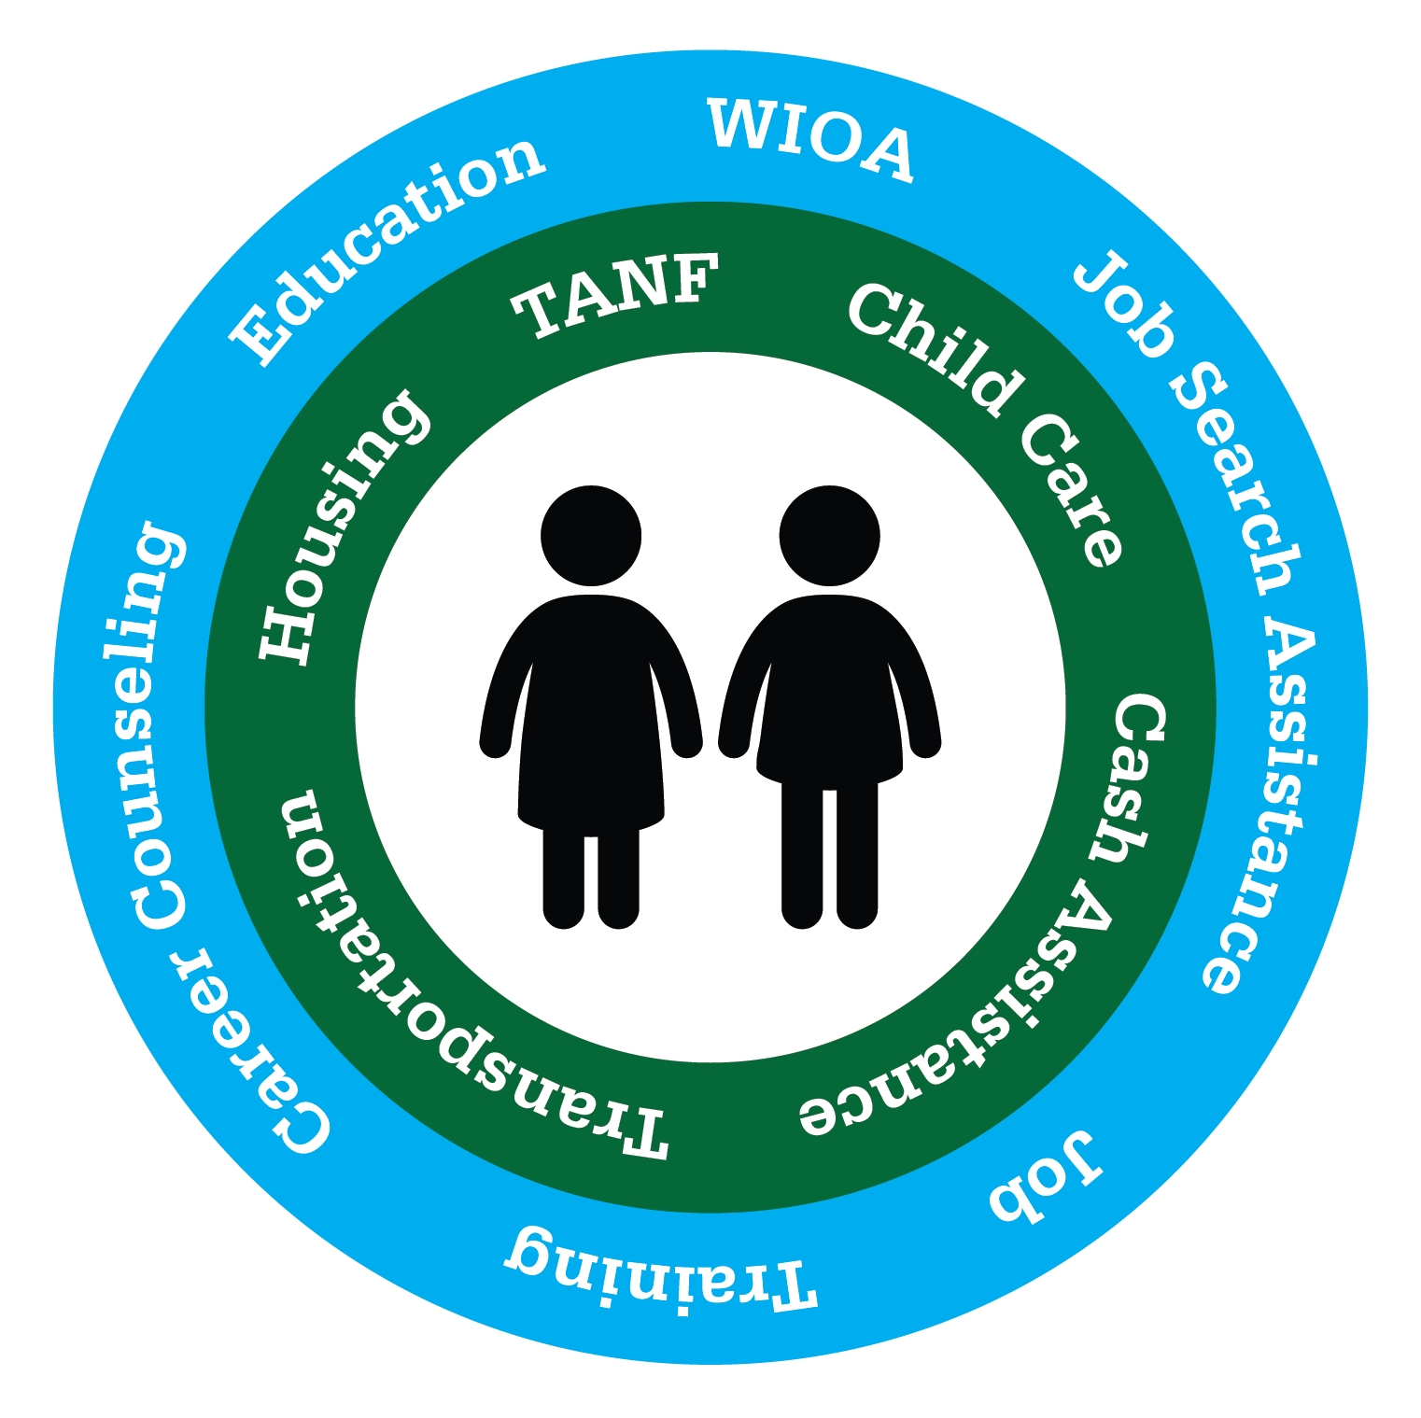
A Person-Centered Approach

Slide 38
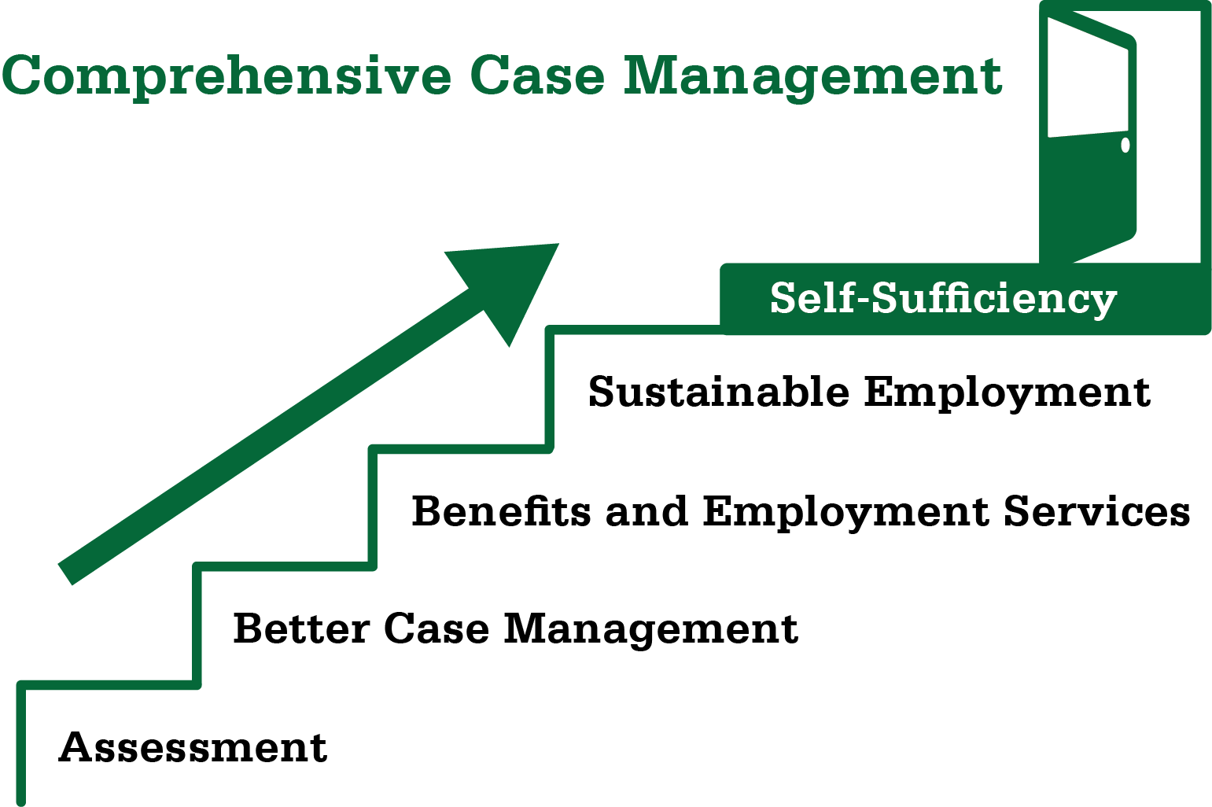
Helping Ohioans Move Up and Out

Slide 39
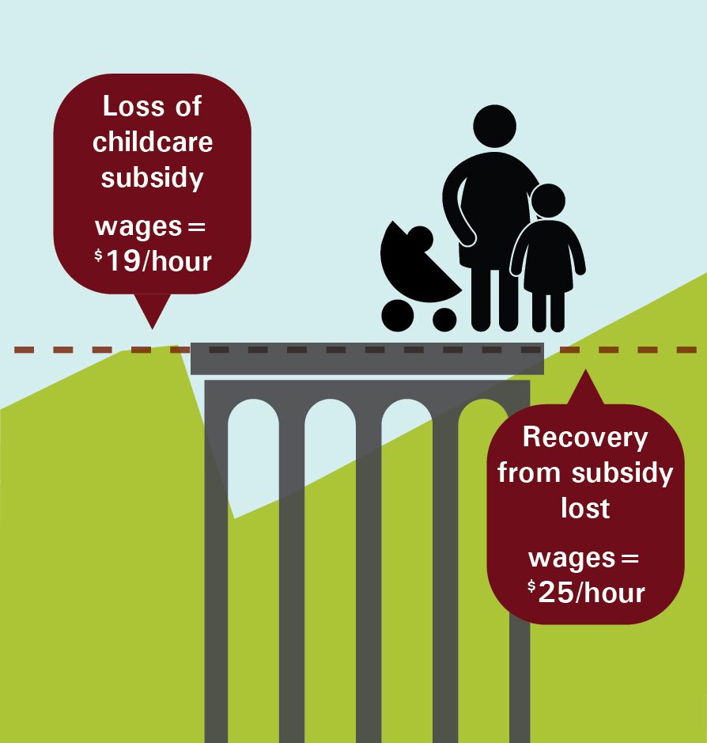
Removing Barriers: Child Care

Slide 40
We must “nurture a climate in which the dignity of hard work – the dignity of hard work – is respected and pays off” and “make sure we are able to catch each other if we fall and help those who struggle live with the dignity and grace deserving a child of God.”
— Governor John Kasich’s Inaugural Address
January 12, 2015

Slide 41
Ohio’s Health Transformation Team
John McCarthy, Medicaid
Bonnie Burman, Aging
Kevin Miller, Opportunities for Ohioans with Disabilities
John Martin, Developmental Disabilities
Tracy Plouck, Mental Health and Addiction Services
Rick Hodges, Health
Cynthia Dungey, Job and Family Services
Greg Moody, Office of Health Transformation

