Slide 1

Higher Education An Investment in Ohio's Future Before the Senate Finance Higher Education Subcommittee Senator Randy Gardner Chair
Testimony
of
Bruce Johnson, President
INTER-UNIVERSITY COUNCIL OF OHIO
April 28, 2015

Slide 2
The Inter-University Council of Ohio
Who is the IUC:
THANK YOU FOR YOUR SUPPORT OF PUBLIC UNIVERSITIES!
Our board is made up of University Presidents.
Represents Ohio’s 14 public universities and 24 regional campuses.
More than 333,000 students.
64% of public college and university students.
71% of the credentials including certificates.
80% of the degrees among public colleges and universities.

Slide 3
Higher Education Continues to be a Sound and Essential Investment
Ohio’s ability to attract and retain jobs hinges on the educational attainment levels of our citizens.
The average annual return for a bachelor’s degree is 15%. (Federal Reserve Bank of New York)
The college wage premium has remained near its all time high. A typical graduate of a four-year college or university will earn, on average, $830,000 more in his or her lifetime than someone with a high school diploma. (Federal Reserve Bank of San Francisco)
The jobs are there. The following chart demonstrates why successfully earning a bachelor’s degree or higher is a solid investment. There is an obvious need for graduates with at least a bachelor’s degree.

Slide 4
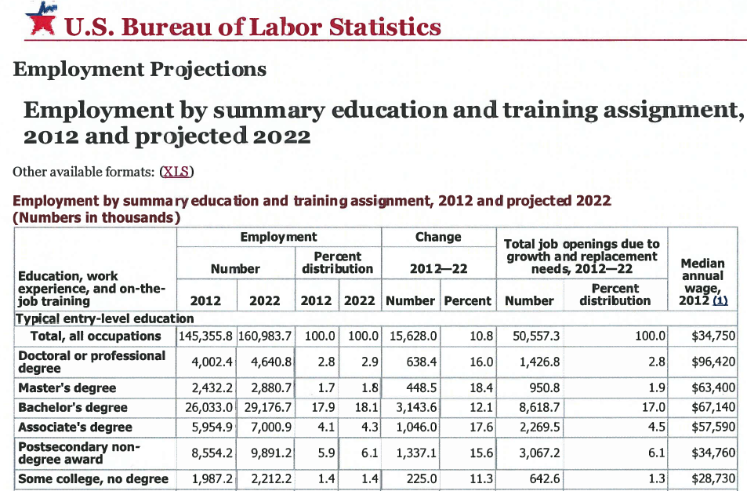

Slide 5
The University’s Role – A Relentless Pursuit of Efficiency While Improving Quality
Leaders of Ohio’s public universities do not want their students to pay more than is necessary for a quality education.
Universities have been working hard to reduce costs, save money, and pass that savings on to students by operating more efficiently.
We have streamlined operations, reduced redundancies, increased innovations in operations, academic program delivery, energy usage, IT, and procurement.
We have utilized shared services to leverage assets and create economies of scale.
We have identified efficiencies in a variety of areas including academics – specifically time to degree, program structure and delivery, and academic advising.

Slide 6


The University’s Role – Research that Gets Results
Ohio State University’s Center for Automotive Research (CAR) – CAR provides facilities and support for six nationally and internationally recognized automotive undergraduate student project teams – the most at any university in the nation.
CAR has been actively engaged with the automotive industry since 1991 and is considered to be a national thought leader in research related to sustainable mobility and automotive technologies.
For FY15 CAR includes: 50 full time staff, 80 graduate students, 250 undergraduate students, and 20+ faculty.
A team of student researchers at OSU’s Center for Automotive Research had a fully functional hybrid electric vehicle that was fit to be sold on the market by its third year of work.

Slide 7


The University’s Role – Research that Gets Results
The University of Cincinnati’s Simulation Center – Is a joint collaboration between UC and Proctor & Gamble created in 2008. The” Sim” Center started with 3 UC students and now has over 50 students working on practical problems to help P&G with the product, process, and systems development ranging from engineering to analytics.
In the Center, students and faculty are embedded virtually in a P&G team to ensure maximum transfer of knowledge and technology to help P&G bottom line.
The return of investment is about 1:7 – which, in 2012, earned UC the P&G Global Business Development Private/Public Partnership Award.
Tide Pods are a result of this relationship. The project performed thousands of computational studies to determine the best shape of the pod chambers to optimize manufacturing and usage (release) of the detergent from within the pods in the washing machine.

Slide 8
Holding Down Tuition Growth
The four-year public university sector in Ohio has the slowest rate of tuition GROWTH than does any other sector in any other state in the nation.
According to the College Board’s Annual Survey of Colleges, Ohio is the national leader in restraining GROWTH of tuition and fees.
Ohio has had the slowest rate of increase over the last 10 years – from 2004-2005 to 2014-2015 – and is the only state in the nation where tuition and fees are below the rate of 10 years ago when adjusted for inflation.
The national statistics and data that are often cited to indicate that Ohio tuition growth is out of control is misleading when used to describe Ohio and is an incorrect application of national statistics.
Working together with Ohio’s public policy makers, we have done much better!

Slide 9
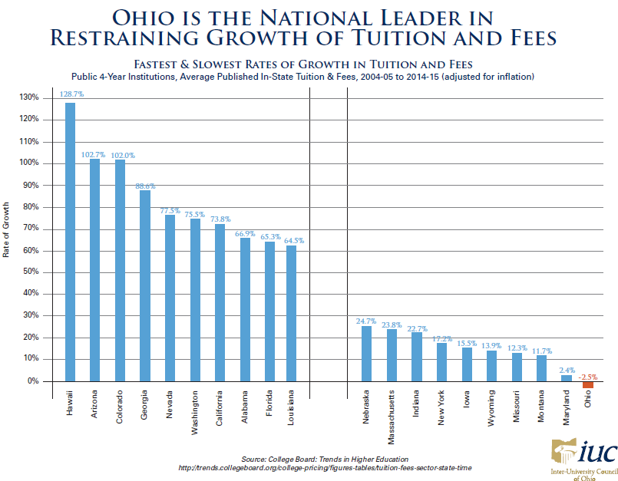
Holding Down Tuition Growth

Slide 10
Holding Down Tuition Growth – The Ohio Guarantee
Am. Sub. House Bill 59, enacted during the 130th General Assembly authorized the Board of Trustees of a state university to establish an undergraduate tuition guarantee program.
Under the program, eligible students in the same cohort will pay a fixed rate for general and instructional fees for four years. Room, board, and any additional fees may be included.
On January 24, 2014, the Board of Trustees of Ohio University adopted an undergraduate tuition guarantee program and submitted it to the chancellor for approval.
On April 1, 2014, the chancellor determined that the program conformed in principle to the parameters and guidelines established in law and approved OU’s tuition guarantee program.

Slide 11
STATE SUPPORT
We are graduating more students as a result of the new funding formula even though it does not fund us on a per graduate basis, and therefore, is not sustainable.
We are holding down tuition growth.
Setting our subsidy through consistent reductions on a per student basis, while virtually setting our price, is a mistake with potentially dire consequences for quality.
What we cannot have and what we should not want is a race to the bottom where Ohio’s public universities are expected to reduce operational costs, improve efficiencies, graduate more students with fewer state dollars on a per graduate basis, and restrain tuition without carefully considering the implications on the overall quality of the programs.

Slide 12
History of SSI Appropriations Over the Last Ten Years
FY09 - $1,842,710,039
FY10 - $1,987,582,377 (GRF + Fed Stimulus)
FY10 - $1,706,304,433 (GRF)
FY10 - $309,874,026 (Federal Stimulus)
FY11 - $1,998,357,633 (GRF + Fed Stimulus)
FY11 - $1,689,299,265 (GRF)
FY11 - $308,802,662 (Federal Stimulus)
FY12 - $1,735,274,323
FY13 - $1,751,225,497
FY14 - $1,789,699,580
FY15 - $1,818,225,497

Slide 13
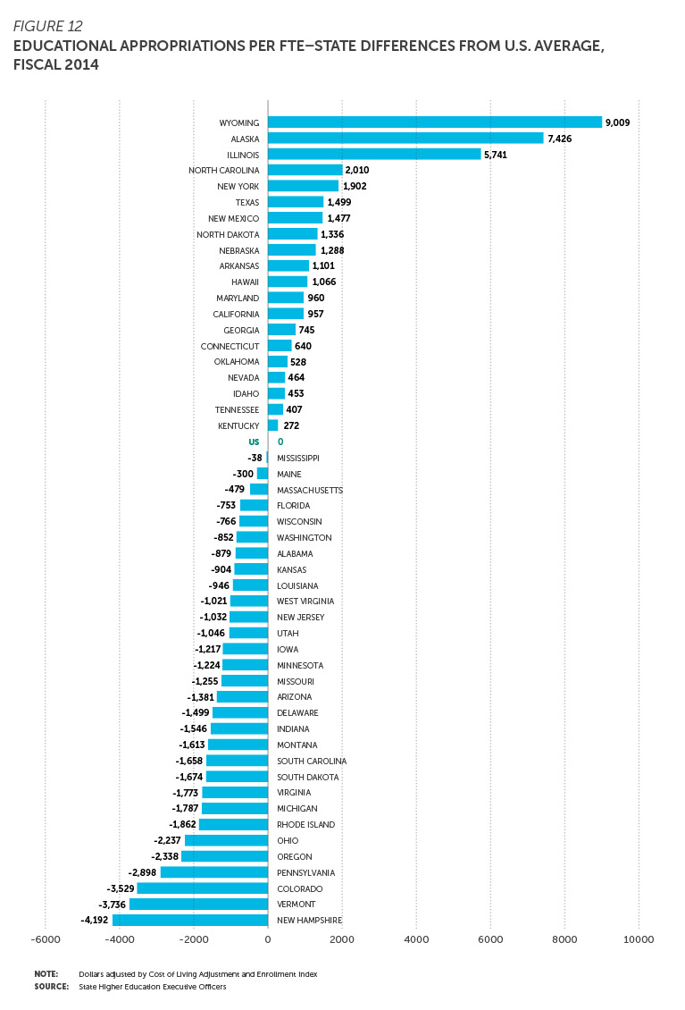

Slide 14
President Faber Supports Additional Funding
Senate President Keith Faber – Columbus Dispatch, April 19, 2015
For months, Senate President Keith Faber, R-Celina, has been talking about doing just that. He issued a challenge to universities to find ways to lower overall student costs by 5 percent, and he said it will be part of the budget expectations.
“I tell them what we want them to do and then give them flexibility in getting there,” he said.
Faber said he expects the Senate will increase higher-education funding.
“Higher education has taken a back seat on the budgetary bus for too long,” Faber said. “They have a cause to argue; if they show efficiency, they should be entitled to some additional state resources.”

Slide 15
State Share of Instruction
From FY09 to FY15, state fiscal support for higher education measured on a per student basis in Ohio has steadily decreased and is now $2,237 below the national average. Only five other states in the nation rank lower than Ohio.
Comparing they year 1989 to 2014, the equation of total revenue (share of tuition versus share of state investment) has essentially flipped, as the following chart demonstrates.
SPECIFICALLY on an inflation adjusted basis in 1998, Ohio Colleges and Universities on average had total revenue of $13,710.
SPECIFICALLY on an inflation adjusted basis in 2014, Ohio Colleges and Universities on average had total revenue per FTE of $11,982.

Slide 19
State Share of Instruction
Based on our success in graduating more students under the new outcome based funding formula – a 19% increase over the last four years – the public university sector in Ohio believes an additional investment in subsidy should be made by the state. We are graduating more students with less!
The new outcome based funding formula is driving changes on campuses that have led to greater degree production, but its impact will be limited and sustainability compromised if the formula is not fully funded.
We would also argue that SSI per FTE has not kept pace with the rate of inflation for a number of years. At the very least, an additional investment in SSI should be made as a result of that rising cost of doing business.
A further argument for additional investment can be made as a result of the tuition caps imposed by the previous versions of the budget and as a result of what the Senate may subsequently impose.

Slide 20
Graduating More Students With Less
The performance based funding formula is working.
Ohio’s public universities have embraced the new higher education funding model that prioritizes and incentivizes course and degree completions by basing all state funding on outcomes rather than on inputs.
Between 2010 and 2014, the number of associate, bachelor’s, and master’s degrees awarded by Ohio’s public universities rose from 57,544 to 68,548 – an increase of 19.1%.
During the same time period, however, higher education funding on a per graduate basis declined by 28.3%.

Slide 21
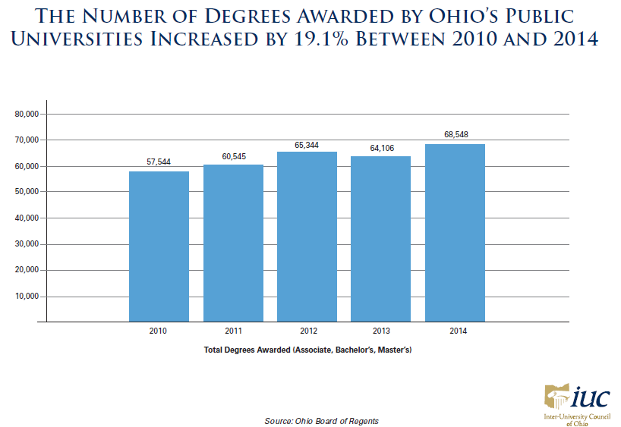
Graduating More Students With Less

Slide 22
State Share of Instruction
As introduced, the budget bill increased funding in FY16 by 2% for the state share of instruction over the current FY15 appropriation. Funding for FY17 was increased by another 2%. WE THANK THE GOVERNOR FOR HIS SUPPORT
However, that appropriation level does not adequately compensate for the proposed tuition caps –
In the “as introduced” version of the bill: 2% or $193 for main university campuses in FY16 and 0% in FY17.
In the “as passed by the House” version of the bill: 2% or $200 for main university campuses for the biennium ending June 30, 2017.
To adequately compensate state institutions of higher education for those caps, the IUC recommends increasing the SSI appropriation for FY16 by 2.5% over the current FY15 appropriation and then, for FY17, increasing that new FY16 appropriation by 5%.

Slide 23
House Bill 64 – Major Provisions and IUC’s Position
Tuition Caps – As previously discussed, the budget permits a tuition increase of up to 2% or $200 (whichever is higher) for main university campuses for the biennium ending June 30, 2017 and 2% or $100 (whichever is higher) for regional campuses and community colleges. Tuition could be constrained in the either year of the biennium, but additional investments should be made. We continue to believe tuition rates should be set by the Boards of Trustees . Without additional investment, we would request a cap of no lower than 2.5% in each fiscal year.
Innovation Fund – The bill establishes the Higher Education Innovation Grant Program and appropriates $20 million in FY17 to that program. The purpose of the fund is to reward public institutions for innovative administrative redesign proposals that will result in cost savings to students. The IUC’s original request for this program was $150 million. The IUC supports this initiative but would recommend additional funding and a reasonable ROI timeline.

Slide 24
House Bill 64 – Major Provisions and IUC’s Position
Student Financial Aid – The bill implements a policy recommendation made by the various sectors to allow students attending year-round to use OCOG once the PELL Grant has been exhausted. The sectors made this recommendation on the condition that it be fully funded. The as introduced bill appropriated $2 million over the biennium and the House passed version of the bill added $10 million over the biennium to bring the total appropriation to $96.1 million in FY16 and $97.1 million in FY17.
The IUC appreciates the additional investment. However, the House changed the distribution method for OCOG dollars so that award amounts to public university students will be reduced and award amounts to private university students will be increased.
The IUC does not support this unfair treatment of public university students and requests that the Senate restore the 2:1 distribution ratio previously agreed to by the state’s public and private institutions.

Slide 25
Student Financial Aid – Impact on OCOG Awards of House Language Changes
The three higher education sectors, OACC, IUC, and AICUO, jointly developed and agreed on a set of proposed recommendations to the Chancellor’s Financial Aid Workgroup.
The chancellor included the recommendations as Exhibit 7 (attached) in his report issued on December 30, 2014.
Several of the recommendations were accepted by the Administration and included in the “as introduced” version of the bill and endorsed again through inclusion in the “substitute” version of the bill.
However, one item included in the bill – the agreed-to recommendation that award amounts to public and private students be made on a 2:1 basis – was subsequently changed by the House omnibus amendment.
That change negatively impacts students attending Ohio’s public community colleges and universities.

Slide 26
Student Financial Aid – Impact on OCOG Awards of House Language Changes
FY/Version of HB 64 | Publics | Private Non-Profits | Private For-Profits
FY 15 Award amounts | $1,048 | $2,568 | $744
HB 64 As Introduced Est. | $1,218 | $2,436 | $840
HB 64 Sub Bill Est. ($10 million increase) | $1,292 | $2,584 | $840
HB 64 Omnibus Am. Est. | $1,146 | $2,872 | $840

Slide 27
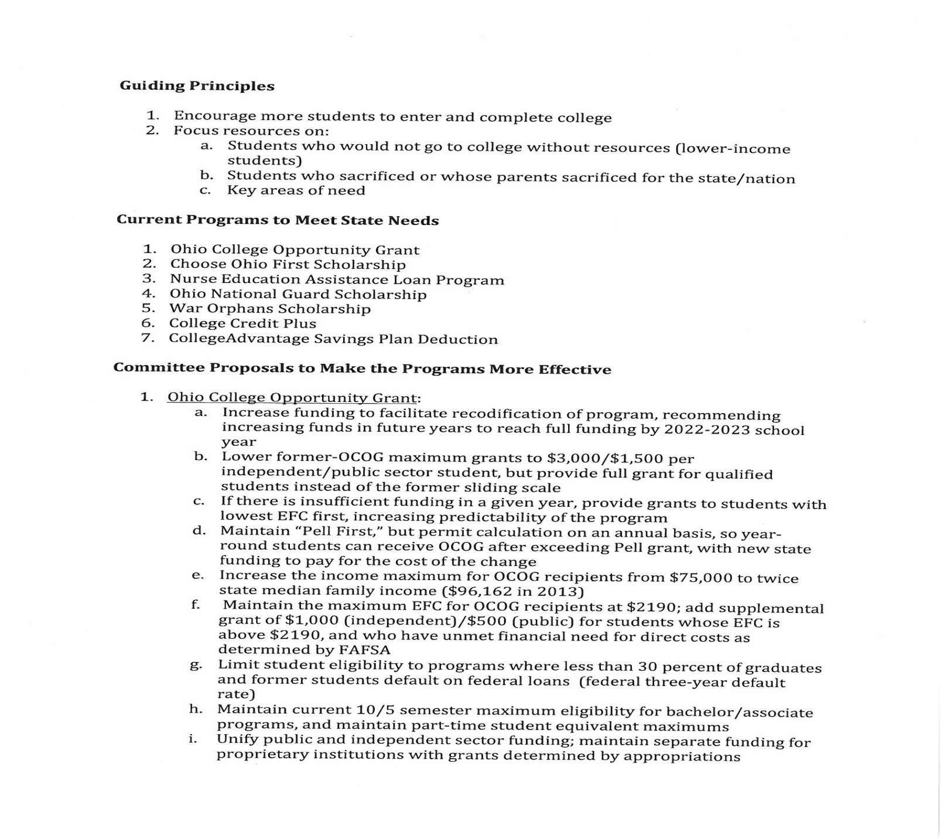
Student Financial Aid – Chancellor’s Report Exhibit 7

Slide 28
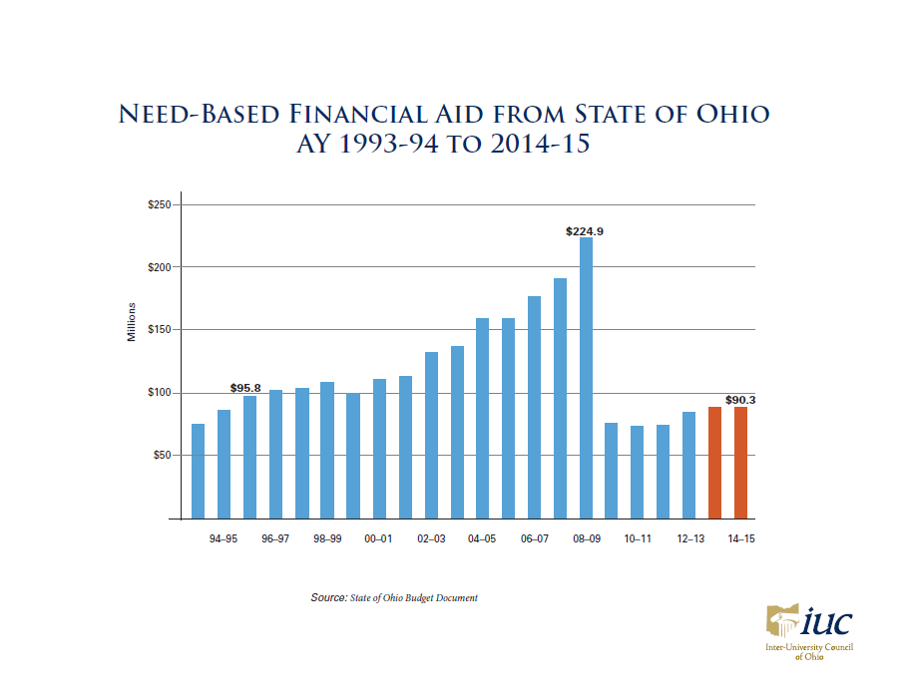

Slide 29
House Bill 64 – Major Provisions and IUC’s Position
Competency-based Credits and Career Advising – The budget appropriates $4 million in each fiscal year to help universities develop online and competency-based bachelor’s and master’s degrees for adults. Under the initial proposal, Ohio’s public universities are provided the opportunity to develop the program. If they are unable to develop a workable plan that satisfies the intent of the Administration, then the state will require the implementation of a program established by the Western Governors University, an out of state provider. The timeline given in the bill is 6 months.
The House replaced the Executive provision with a provision that requires institutions that choose to offer competency-based education programs to submit plans to the BOR by July, 1, 2016 and be granted “reasonable” time to implement them.
The IUC is requesting that the Senate maintain the language as passed by the House.

Slide 30
House Bill 64 – Major Provisions and IUC’s Position
Student Debt Reduction Program – The budget as passed by the House appropriates $7.5 million in each fiscal year for the purpose of reducing debt and financial burdens on students attending Ohio’s public institutions of higher education. The IUC supports affordability, but believes that these funds could be better used in other ways.
The IUC requests that these funds be re-tasked to fund the state share of instruction. The IUC also would support the funds being utilized to support the Higher Education Innovation Grant Program or OCOG.

Slide 31
House Bill 64 – Major Provisions and IUC’s Position
Teacher Preparation – There was language in the budget permitting the Chancellor to establish statewide minimum standards for entry into all educator preparation programs approved under ORC section 3333.048. It was removed by the House.
The IUC believes that the focus should be on outcomes rather than inputs and that any perceived problem in the quality of the “output” will manifest during the licensure process. Setting input standards may preclude an individual from attempting to pursue their dream, rising to meet a challenge, and progressing through to completion in an area that could lead to a credential if, because of the standards, the individual never gains entry into the program.
The IUC opposes the state making this determination and requests that the provision not be included in the bill.

Slide 32
House Bill 64 – Major Provisions and IUC’s Position
Campus Safety – The Budget appropriates $2 million in new funding in FY16 to fund the development of model best practices for preventing and responding to sexual assault and protecting students and staff who are victims of sexual assault on campus. The chancellor is required to convene state institutions of higher education in the training and implementation of best practices regarding campus sexual assault.
The IUC supports the Board of Regent’s lead role in cooperation with the Attorney General in this initiative and safety on campus.

Slide 33
House Bill 64 – Major Provisions and IUC’s Position
Ohio Task Force on Affordability and Efficiency in Higher Education – The bill includes language instructing universities on what to do with the recommendations issued by the Governor’s Task Force that was created by Executive Order 2015-01K.
The budget language requires all boards of trustees for state institutions of higher education to complete, by July 1, 2016, an efficiency review based on the report and recommendations of the task force, and provide a report to the Director of Higher Education within 30 days of the completion of the efficiency review that includes how each institution will implement the recommendations and any other cost savings measures.
The House modified the language to require that the recommendations be submitted to and approved by the General Assembly before implementation.

Slide 34
House Bill 64 – Major Provisions and IUC’s Position
College Credit Plus - The budget proposes that CCP be the sole mechanism by which state funds are paid to colleges for students who earn college credit while enrolled in high school.
The budget also proposes that a biennial report on "quality assurance measures" related to CCP be submitted by the Chancellor and the Superintendent of Public Instruction.
The IUC strongly supports the CCP Program and these changes as a way to reduce a student’s time to degree, and thereby costs to students.

Slide 35
House Bill 64 – Major Provisions and IUC’s Position
Co-op & Internship Program – The House passed version of the budget appropriated $9,250,000 in each fiscal year for this program. The goal of which was to encourage institutions of higher education to create academic programs that attract and retain students through workplace education. These programs then collaborated with local businesses and encouraged students to stay in the state after graduation.
The IUC supports the mission of the program because it fosters the growth of Ohio's businesses by providing those businesses with Ohio's most talented students while providing Ohio graduates with job opportunities. Statistics show that students with an internship are more likely to be employed in Ohio. The IUC requests that the Senate support the Co-op & Internship program and provide an appropriate amount of funding to accomplish its mission.

Slide 36
The Bottom Line is About Reducing Costs for Students
The IUC supports reducing costs for students and their families and believes the single most effective way to do so is by reducing time to degree.
Reducing time to degree will not only save students money but will get them into the workforce sooner.
Most full-time students do not take the necessary amount of credits per semester to graduate on time or they wander and take more credits than they need.

Slide 37
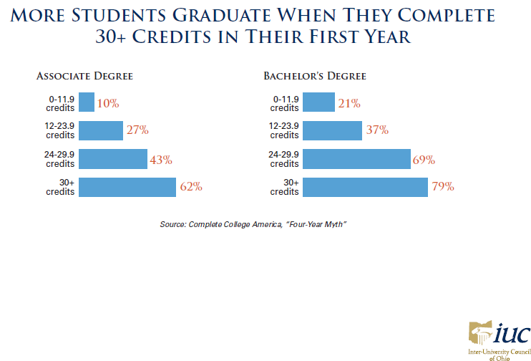

Slide 38
Conclusion
Ohio needs more university graduates.
Higher Education needs to be a greater funding priority for the state – especially in terms of State Share of Instruction.
Consistent with the Senate President’s public comments, the IUC requests additional investment – increasing the State Share of Instruction by the amount necessary to compensate for any tuition restraint currently being considered by the Senate – in order to help universities maintain affordability and achieve meaningful cost reductions.
Ohio’s public universities are committed to quality, affordability and working hard to reduce costs.
Allow state institutions of higher education the flexibility to do the job you have entrusted us to do.

Slide 39
Questions

