Slide 1
Informational testimony on Health education Standards
tuesday, December 3rd, 2019

Slide 2
overview
Defining subject area standards
Processes for state subject area standards
Health education standards
  Background
  Trends
  Examples
Questions

Slide 3
What are subject area standards?
Evidence-based guidelines to achieve developmentally appropriate competencies.

Slide 4
What are subject area standards?
Informed by research
Take into account students’ ages, abilities, and social-emotional development
Identify benchmarks and indicators for knowledge acquisition
Not necessarily attached to assessments

Slide 5
But what about curriculum?
Standards are to curriculum as…

Slide 6
But what about curriculum?
Destination is to roadmap
Meal is to recipe
Dancing is to choreography
Hypothesis is to method
Notes:
Standards identify a goal for student knowledge, while curriculum is the specific content and strategies that are used to impart that knowledge
Standards are what we want students to learn, and curriculum is how it is taught.

Slide 7



Standards vs curriculum: example

Slide 8
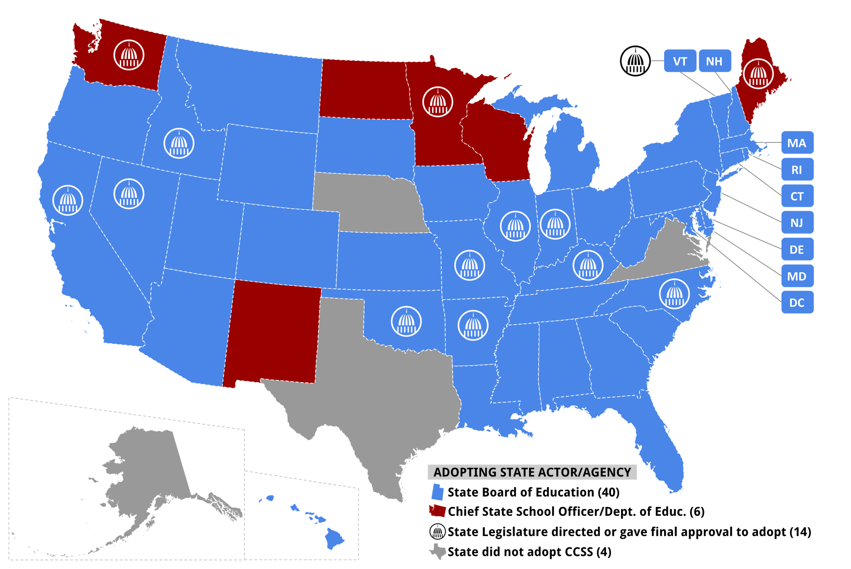
Notes:
Ohio similar to Texas – legislature can take specific statutory action to limit or override SBOE

Slide 9
State processes for subject area standards
Adopted by state boards of education in 44 states
Varying levels of legislative oversight or review
Most standards are adopted as administrative rules rather than statutes
Notes:
Ohio similar to Texas – legislature can take specific statutory action to limit or override SBOE

Slide 10
Health education standards
National Health Education Standards (NHES) – developed by Centers for Disease Control joint committee in 1995, updated in 2007
49 states have adopted health education standards
25 states replicate NHES, many others adapt from a similar model

Slide 11
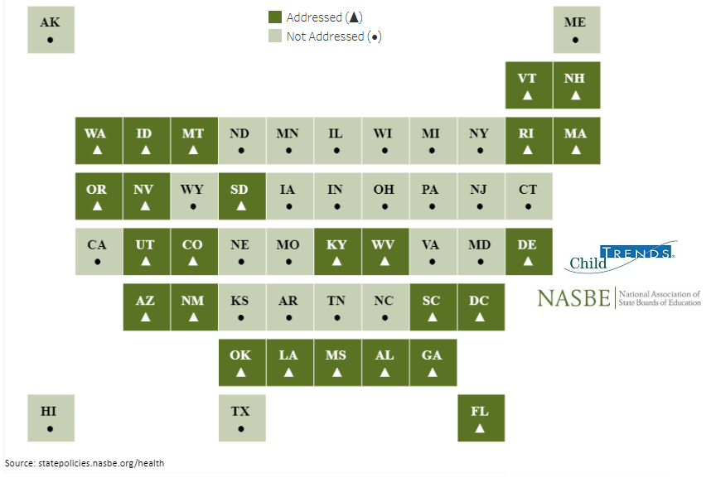

Slide 12
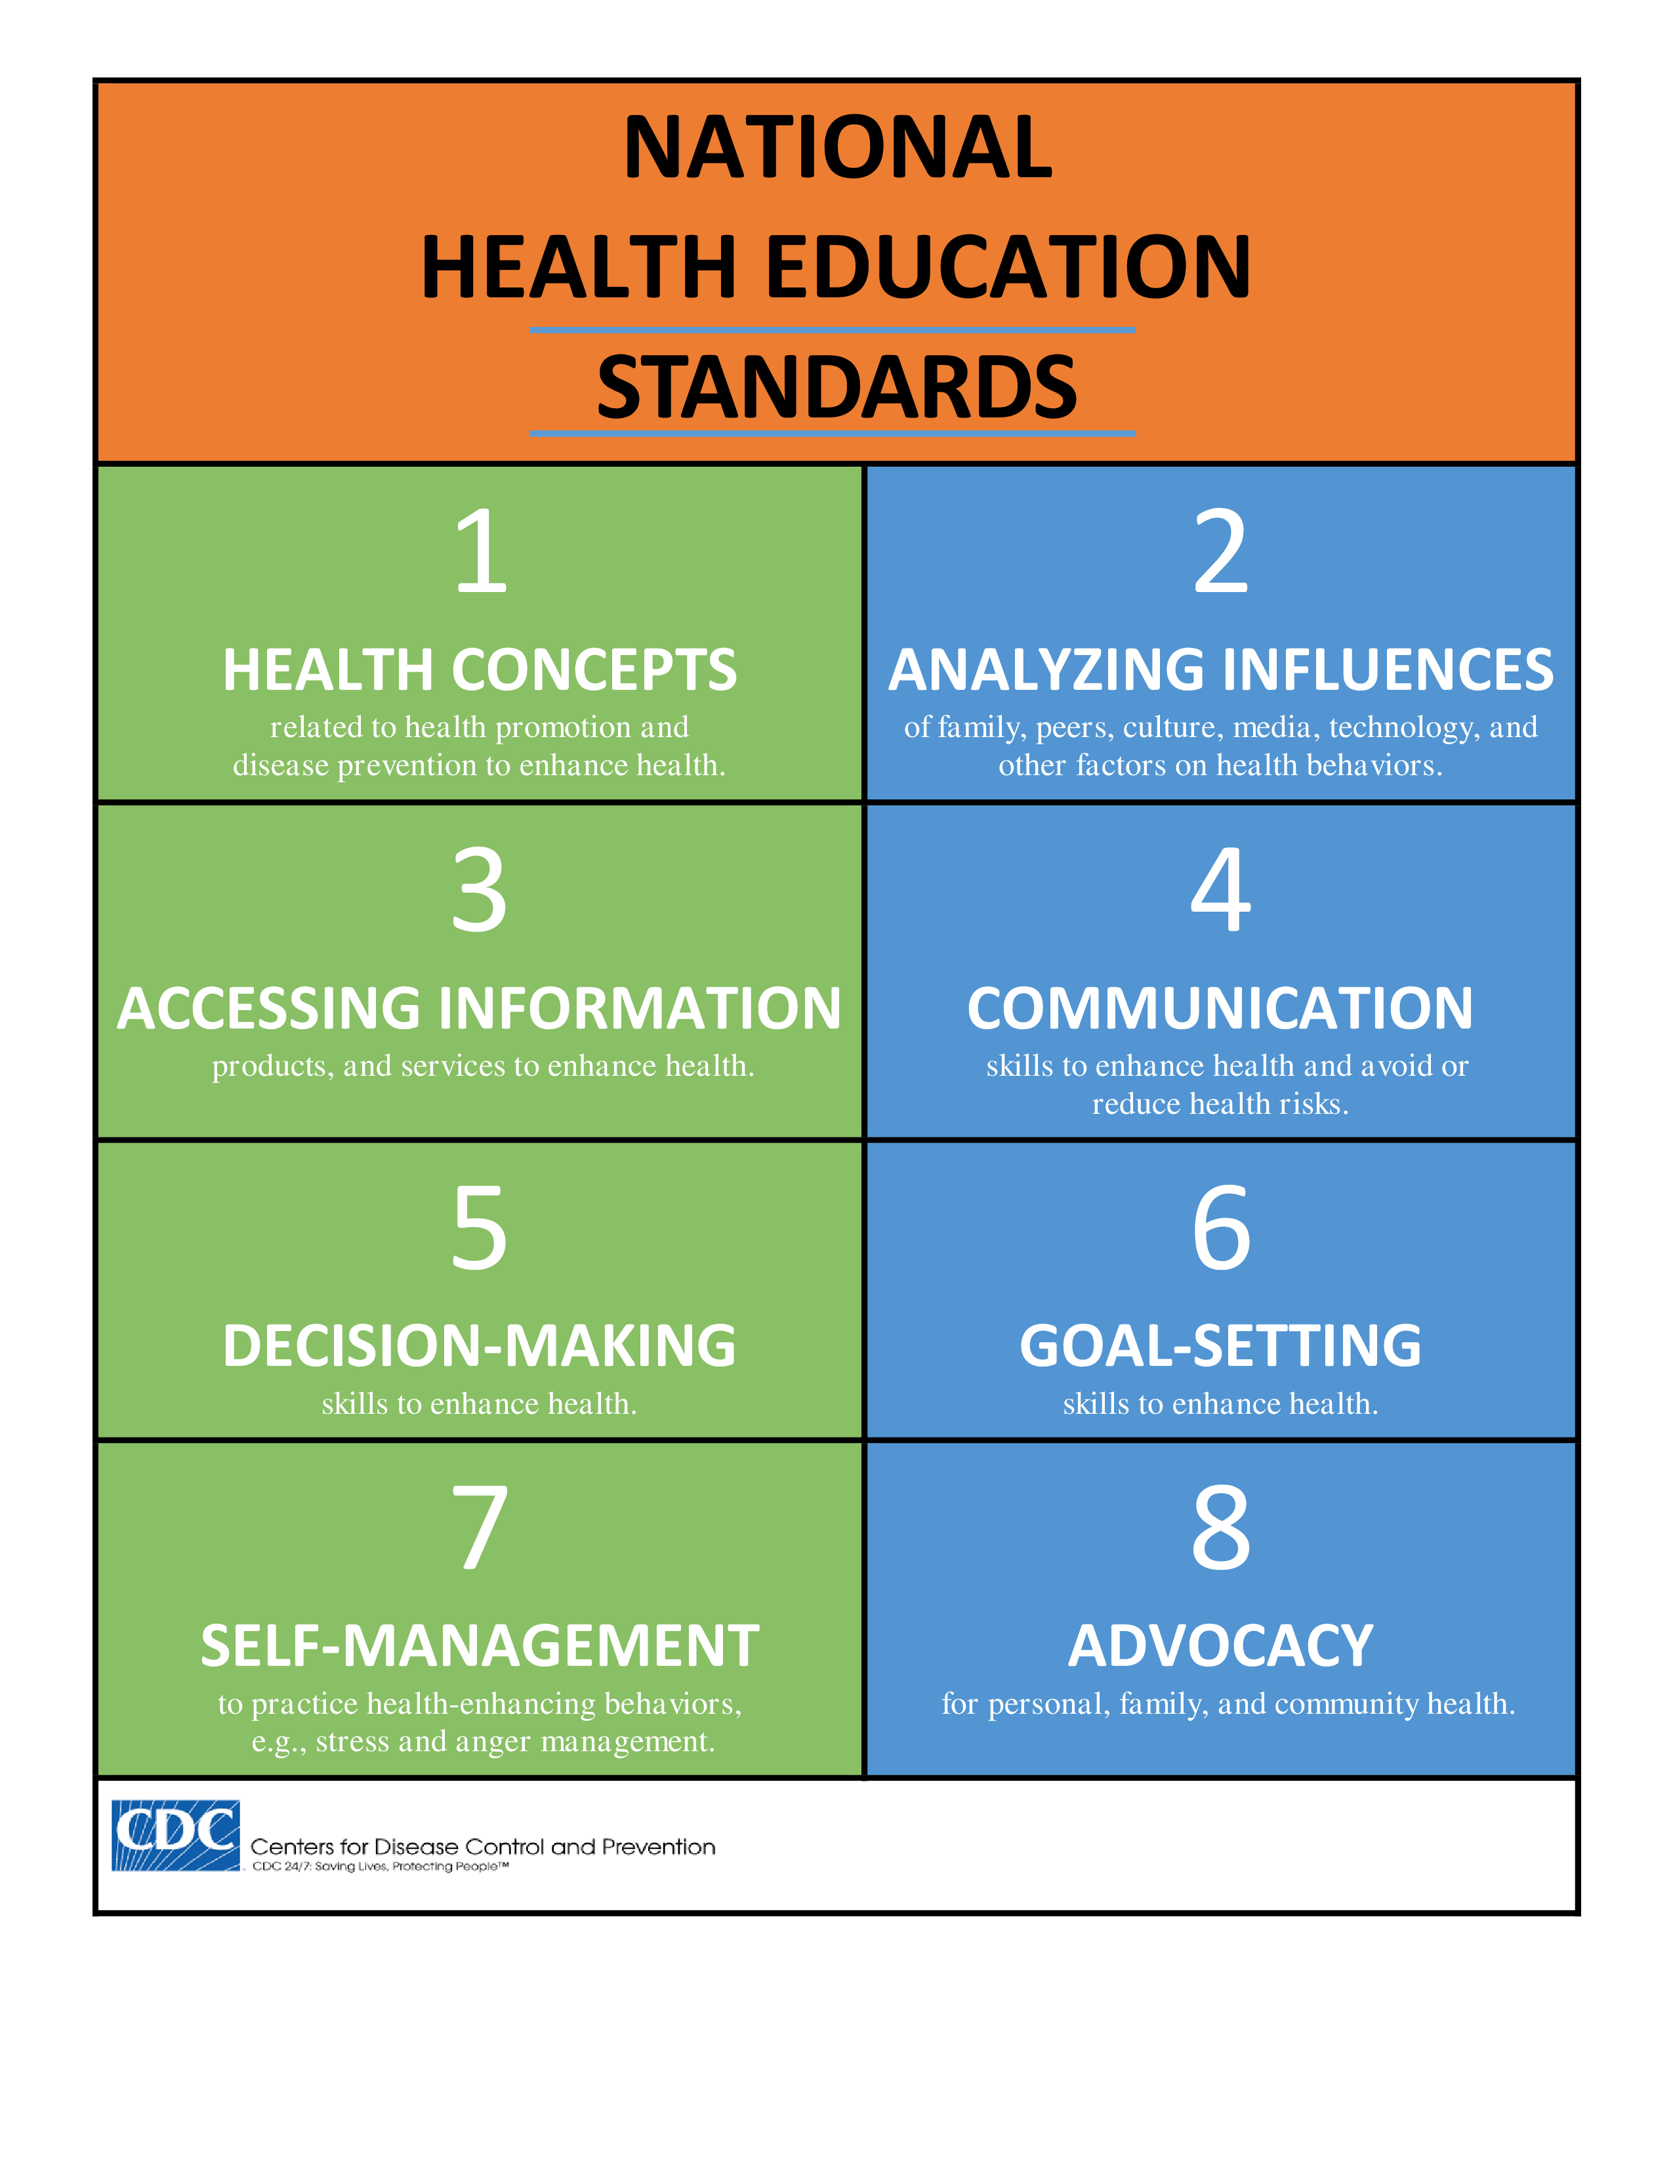

Slide 13
Example: NHES standard 1
“Students will comprehend concepts related to health promotion and disease prevention to enhance health.”
Pre-K-Grade 2
  Identify that healthy behaviors impact personal health
Grades 3-5
  Describe the relationship between healthy behaviors and personal health
Grades 6-8
  Analyze the relationship between healthy behaviors and personal health
Grades 9-12
  Predict how healthy behaviors can affect health status

Slide 14
Questions?
Adrienne Fischer
Policy Associate
Adrienne.fischer@ncsl.org
303-856-1544

