Slide 1
Impacts of a Nuclear Shutdown
Dean Murphy
June 2019
Prepared for Nuclear Matters

Slide 2
This presentation was developed for Nuclear Matters and FirstEnergy Solutions Corp.
The views expressed here are strictly those of the presenter and do not necessarily reflect the views of The Brattle Group or its clients.

Slide 3
Impacts of a Nuclear Shutdown
There are two primary impacts of losing a nuclear plant:
Emissions increase
Lost nuclear output is replaced almost entirely by increased fossil generation
With attendant increase in emissions
Electricity prices rise
Law of Supply and Demand: A reduction in supply raises price
Market’s response partially mitigates the price increase

Slide 4
Nuclear Shutdown causes Increased Emissions
In the short term, lost nuclear generation is replaced by fossil – mostly gas; some coal
More fossil generation means increased emissions: CO₂, as well as SO₂, NO_{X}, particulates, etc.
One nuclear unit prevents about 4 million tons CO₂ annually
This is the CO₂ emissions of 900,000 cars
Equivalent to 20% of the autos in Ohio or Pennsylvania

Slide 5
Can Nuclear be Replaced by Renewables?
Renewables are unlikely to replace emission-free nuclear generation in the near term
Existing renewables generate the same whether nuclear operates or not
Similar for new renewables that would be built anyway
To offset lost nuclear, must add still more new renewables
More than would be added otherwise, and much faster
This raises a question of scale and pace

Slide 6
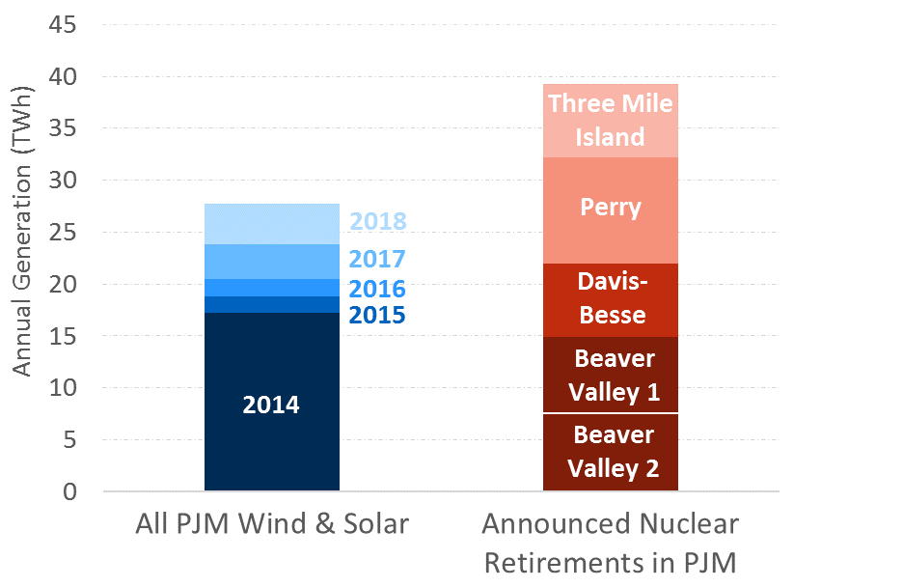
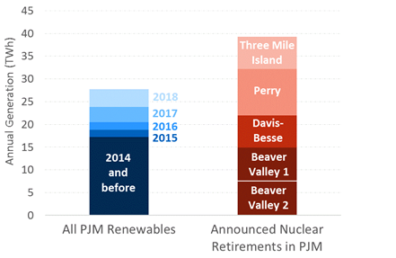
Relative Scale of Nuclear and Renewables
One large nuclear unit generates as much emission-free power as 30% of all existing PJM renewables (wind, solar)
Accounts for over 3 years of recent PJM renewable growth
Ohio renewables provide 1.7 TWh, ~6% of PJM renewables
Source: Generation within PJM footprint via ABB Velocity Suite from EIA Forms 906/923 (2018 estimated; data incomplete).
Substituting renewables for nuclear means falling behind in the growth of emission-free generation

Slide 7
Nuclear Shutdown Causes Higher Electricity Prices
Question: How can closing a relatively costly plant
(one having trouble covering its costs in the market)
cause power prices to rise?
Power price is based on generator offers into hourly wholesale markets
Offers reflect only short-run variable costs (primarily fuel, for most plants)
Just enough generators are run to meet current-hour load, lowest offers first
Price is set by the offer of the highest-cost generator needed in that hour
Nuclear’s short-run cost is very low
Nuclear offers $0/MWh and runs in all hours – as long as it operates
Even if price does not cover its ongoing fixed costs (largely labor) on an hourly basis
Fossil alternatives – existing or new – offer at higher prices reflecting their variable costs (mostly fuel)
Thus short-term market price is higher if more fossil is called on

Slide 8
Nuclear Shutdown Causes Higher Electricity Prices
Law of Supply and Demand (short-term effect):
Reduction in supply causes higher prices – this is widely agreed
PJM study on nuclear impact, June 5, 2019: $95M/yr in Ohio (without capacity price effect)
Preventing retirement in order to hold prices down is not a legitimate policy goal in itself, and can harm markets and customers in the long run
However, price impacts may be a side effect of a policy that pursues legitimate goals, such as emission reduction, by addressing gaps in competitive power markets (emissions externality)
The electricity price effect may help to offset the costs to customers of such a policy

Slide 9

Presenter Information
Picture goes here
Size: 1.3”H x 3.2” W
DEAN MURPHY
Principal│ Cambridge
Dean.Murphy@brattle.com
+1.617.864.7900
Dr. Murphy is an economist with a background in engineering. He has expertise in energy economics, competitive and regulatory economics and finance, as well as quantitative modeling and risk analysis. His work centers on the electric industry, encompassing issues such as resource and investment planning (including power and fuel price forecasting), valuation for contract disputes and asset transactions, climate change policy and analysis, competitive industry structure and market behavior, and market rules and mechanics. He has addressed these issues in the context of business planning and strategy, regulatory hearings and compliance filings, litigation and arbitration. Dr. Murphy has examined these matters from the perspectives of investor-owned and public electric utilities, independent producers and investors, industry groups, regulators, system operators, and consumers.
Dr. Murphy holds a Ph.D. in Industrial Engineering and Engineering Management and an M.S. in Engineering-Economic Systems, both from Stanford University, and a B.E.S. in Materials Science and Engineering from the Johns Hopkins University.

