Slide 1
Taxes and Fragmentation
Presenter: Ron Ott
OTT’S LOST FOREST
380 Acres Woodland Farm
Tippecanoe, Ohio
Harrison County
1996 Ohio Tree Farm of the Year
1998 North Central Regional American Tree Farm of the Year
1998 Al Fabian Landowner Conservation, Ohio Turkey Federation
2004 Conservation Forest Farmer of the Year
(Harrison Soil & Water District)
330-867-5660
ronott@att.net

Slide 2
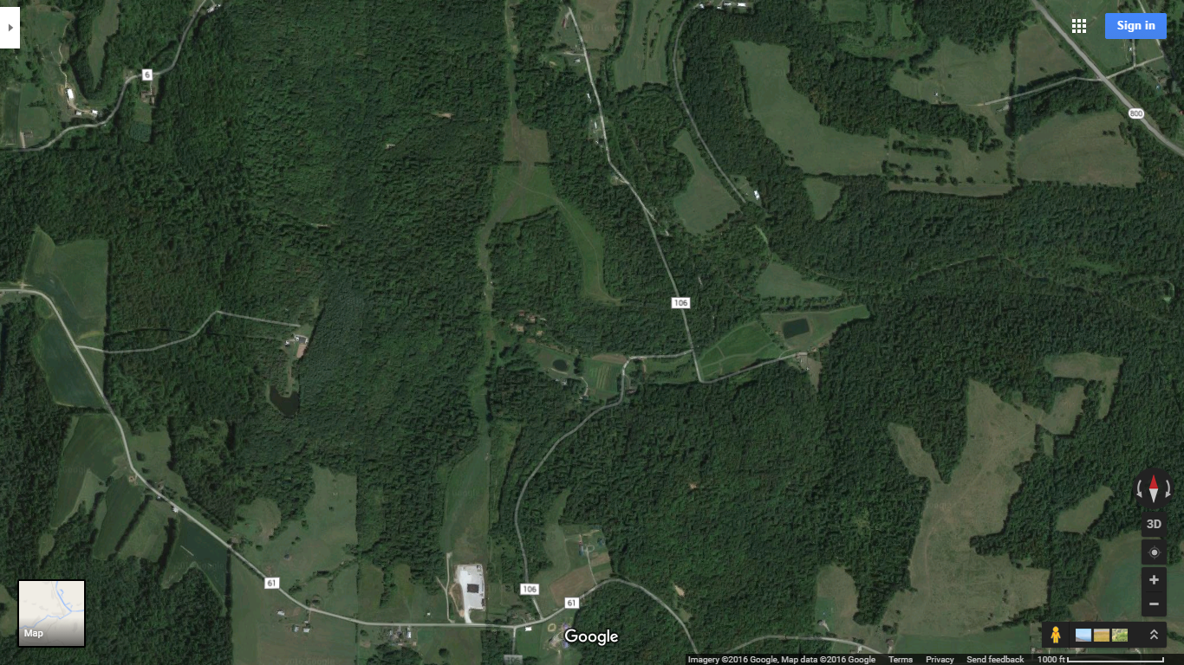

Slide 3
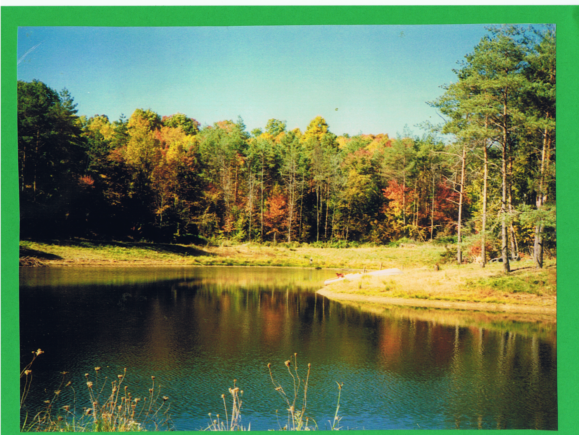
Taxes and Fragmentation
CONCERNED WOODLAND OWNERS

Slide 4
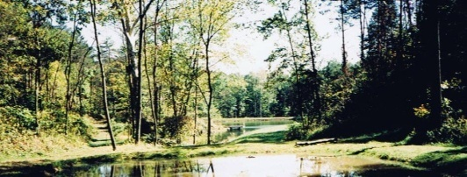
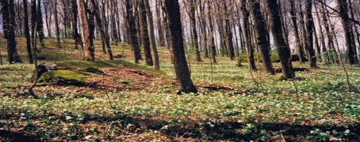
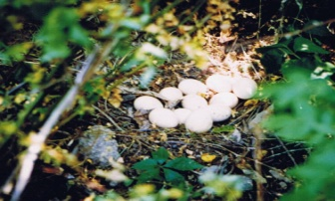
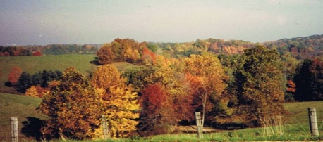
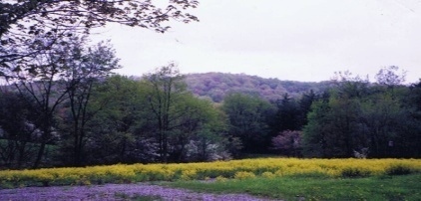
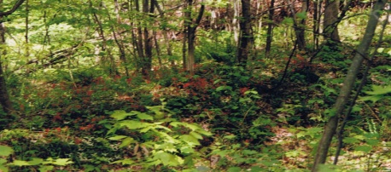

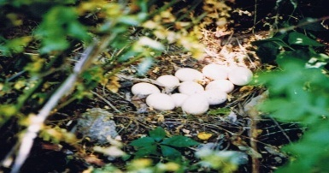
Suggested Name
Woodland Owners Incentive Tax Plan

Slide 5
Current Legislation
Forest Land is under Agriculture Purpose
The amendment providing for the current CAUV of ten acres or
more was added to the Ohio Constitution in 1973. It is based on 3200 types of soil and terrain of the land. CAUV is approximately 80% tax reduction.
A 1993 amendment to the law allows for tracts of land containing timber, whether grown for a commercial purpose or not, to qualify for CAUV if the tract is contiguous to, or part of a larger parcel of Land that otherwise qualifies for CAUV. Woodland owners who own forest land alone, which is agriculture, qualify for CAUV, but are treated differently by auditors in 88 counties in Ohio.
Ohio Forest Tax Law was established in 1925 when Ohio had less than 14% forest and is controlled by the Ohio Division of Forestry. This plan is a 50% tax reduction on 35% appraised value . It has required management with current free service management plans from Service Foresters.
A.
B.

Slide 6
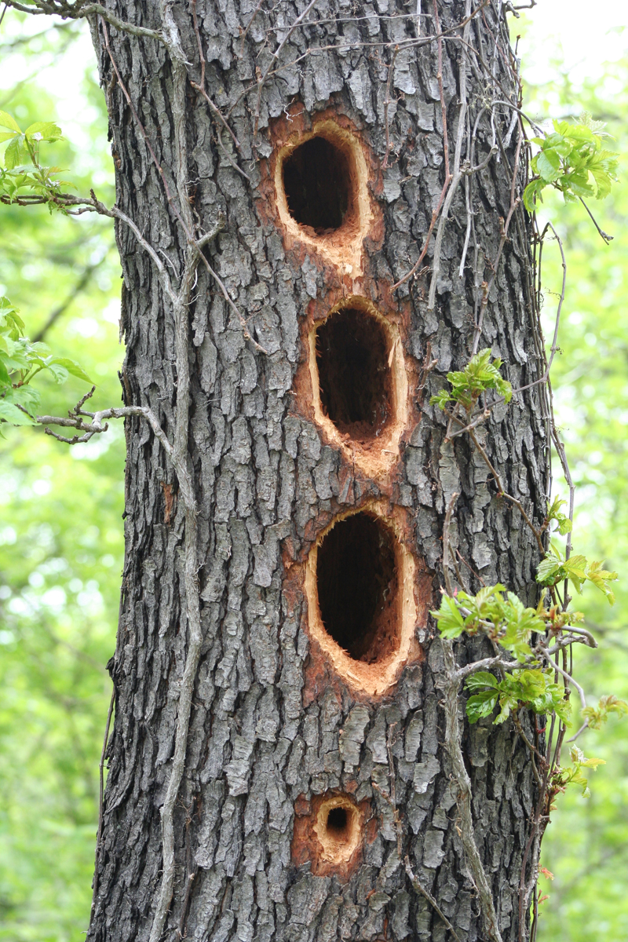
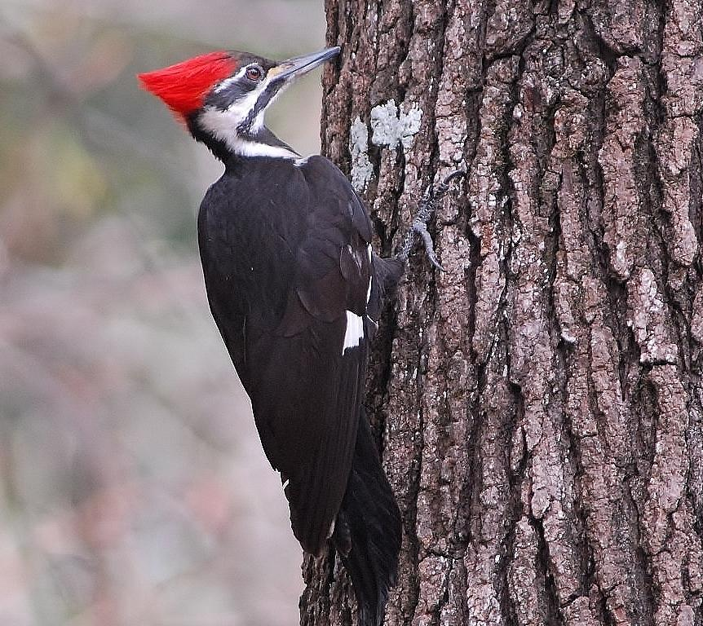
Pileated Woodpecker
Cherry Trees will NOT grow as timber in poor soil conditions, in some Ohio glaciated areas

Slide 7
Reasons
We need a simple tax plan to qualify all woodland forest landowners in Ohio.
Help keep forest land together.
Recognize woodland owners for having their forest lands and all they accomplish.
Encourage more forest land in Ohio.
Protect woodland owners from being forced out of owning their woodland.
Protect woodland owners from unrealistic property tax.
Protect woodland owners from urban development.
We must make it cost affordable to own forest woodland.
Do not discriminate against senior citizens or handicapped to keep their land together and afford to pay their taxes.

Slide 8
Treat woodland owners equal to farmers
who own woodlands.
Investments in woodlands depend on age of
trees, age of landowners, periods of
investments (i.e. thirty to sixty years), value of
tree stands, risky market investments, disease
and invasive plants.
Woodland thirty years ago was considered
waste land. What increased some values in
forestland was wildlife, recreation, and road
access.

Slide 9
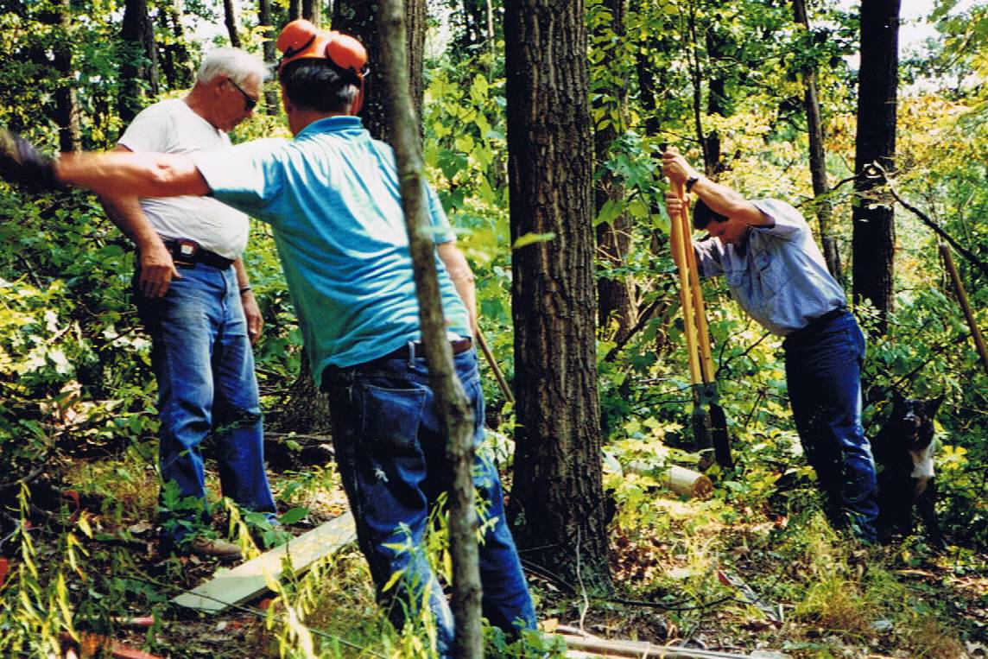
Benefits that woodlands provide:
a) Trees take in carbon dioxide and
put out oxygen
b) Water control
c) Soil retention
d) Wildlife
e) Hunting
f) Cleaner streams
g) Herbs, mushroom, ginseng
h) Recreation
Photo: Frank Bures

Slide 10
Help with the growth of 10% timberland
in Ohio in 1900 to over 30% today.
15. Trees take in more carbon dioxide and
put out more oxygen than grasses;
possibly three times more.
16. Forest landowners provide a multi-
million dollar outdoor recreational
industry.

Slide 11
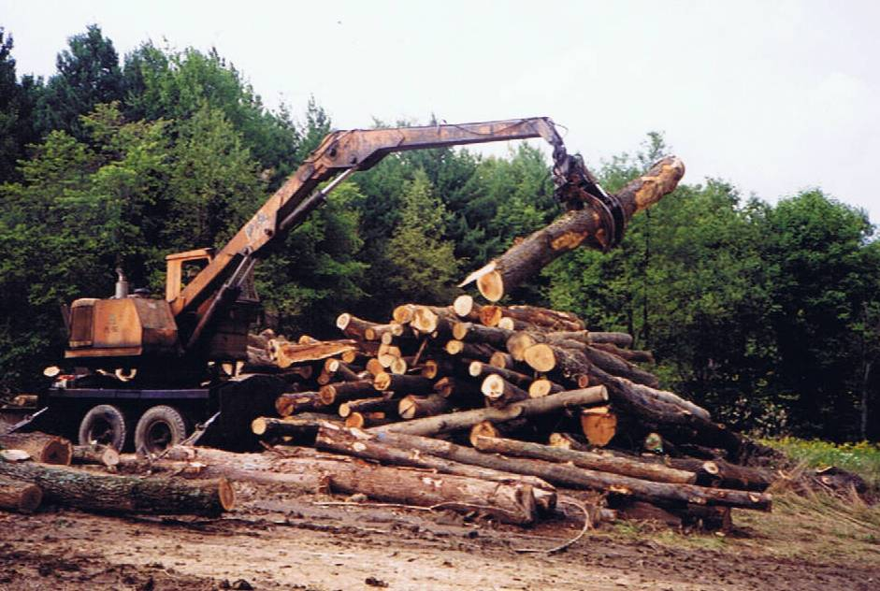
17. Valuable wood resource for homes, furniture, and paper.
Woodland owners provide a valuable resource for the
forest industry of Ohio when in full production.
a) Produces $15.1 billion in forest products
b) Employs 119,000 people
c) Generate $4 billion in annual employee
wage tax.
[source: News Release Dec 27,2006 Ohio Dept of Natural Resources]

Slide 12
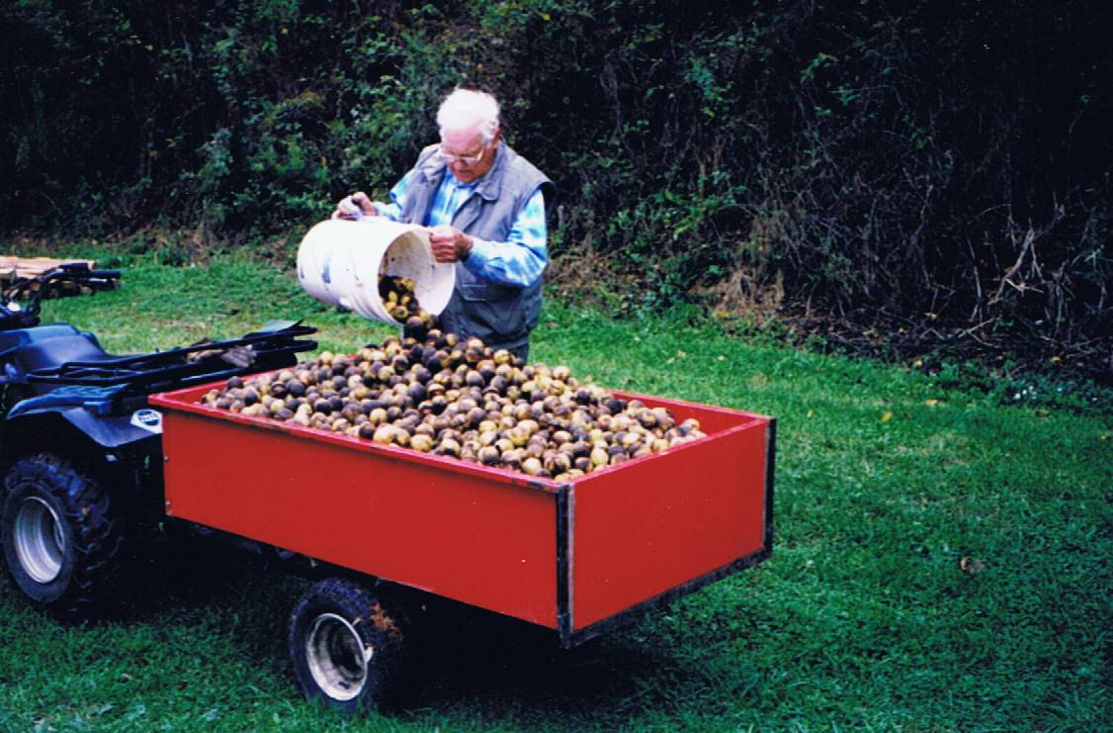

d) Between 300 and 500 million
board feet each year are cut
for paper and wood products. This allows wood to be a RENEWABLE RESOURCE.
Scenic beauty
of Ohio Forest.
Glenn Waggy and King hickory nuts Photo: Lowell Waggy

Slide 13
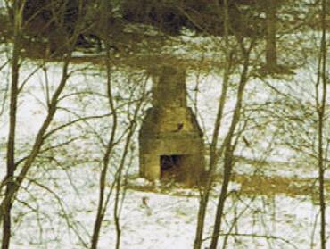
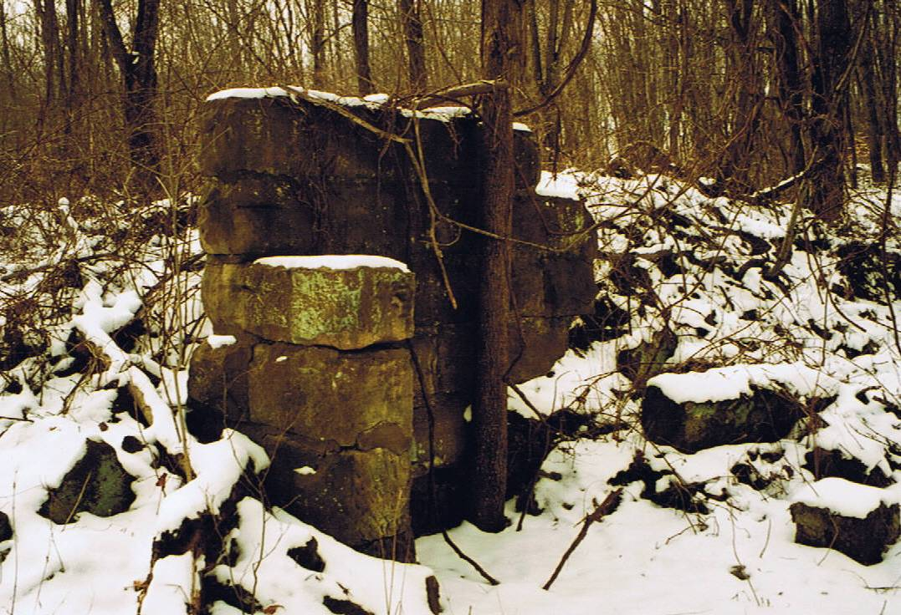
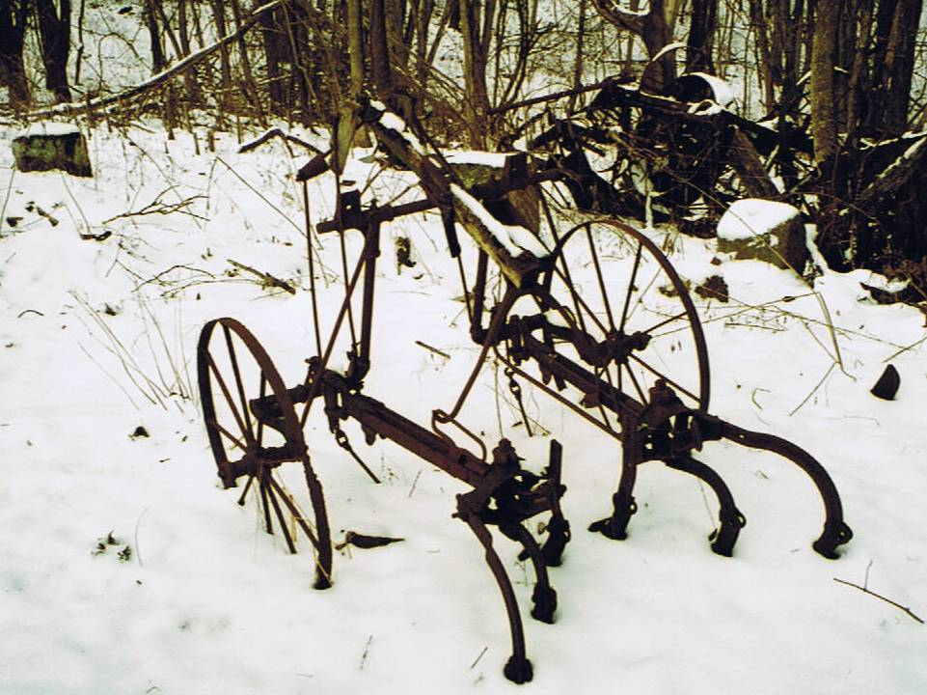
In the early 1800’s, Ohio was covered with unbroken forest. Early settlers cleared the Ohio Forest to less than 10% forest by 1900. Because poor soil conditions, many farmers could not make it, especially in the hilly areas. They lost everything.
Their sacrifices of their farmland brought back much of the 30% forestland we have in Ohio today. We must not repeat our Ohio loss of woodlands. We must sit down and create incentive programs for woodland owners.

Slide 14

BACKGROUND: Affordability
Ott’s Lost Forest-Revenue
Purchased 1984
Acreage 86+92+89+72+40
60-100 years for hard wood trees to mature
Oak, Hickory, Maple, Poplar, Cherry, Beech,Sycamore
Timber cuts
Grossed $115,314
Cost share $ 11,992
Total $127,306

Slide 15
BACKGROUND: Affordability
Ott’s Lost Forest - Expense: Taxes
2008 TAXES $673.00
2009 Taxes = $737.02
2013 Taxes = $1925.42
2015 Taxes = $3896.36
Over 600% increase over 7 years
Doubled in the last 2 years

Slide 16
BACKGROUND: Affordability
Ott’s Lost Forest - Expense: Taxes
2008 TAXES $673.00
2015 TAXES $3896.36
2016 TAXES $4546.58
Average per acre
86 acres = $3.80
92 acres = $1.15
89 acres = $1.16
72 acres = $1.29
40 acres = $1.16
Average per acre
86 acres = $15.96
92 acres = $10.98
89 acres = $8.04
72 acres = $4.48
40 acres = $11.16
Average per acre
86 acres = $18.76
92 acres = $13.02
89 acres = $9.34
72 acres = $5.26
40 acres = $13.11

Slide 17
BACKGROUND: Affordability
Ott’s Lost Forest – Expense: Resources
Expense - Resource
Expense-Cost
1983-2015 Land
Road Management
Heavy Equipment
Light Equipment and Tools
Repairs
Herbicides
Taxes
31 years X $18,900 = $585,900.59
Estimate Less Free owner labor at 600 hours per year x $40.00 per hour = $24,000 × 31 years = $744,000

Slide 18

BACKGROUND: Affordability
Ott’s Lost Forest - Deficit
$585,900.59 -$127,306 = $458,594.59
LESS 31 years Estimate Owner Labor -$744,000

Slide 19
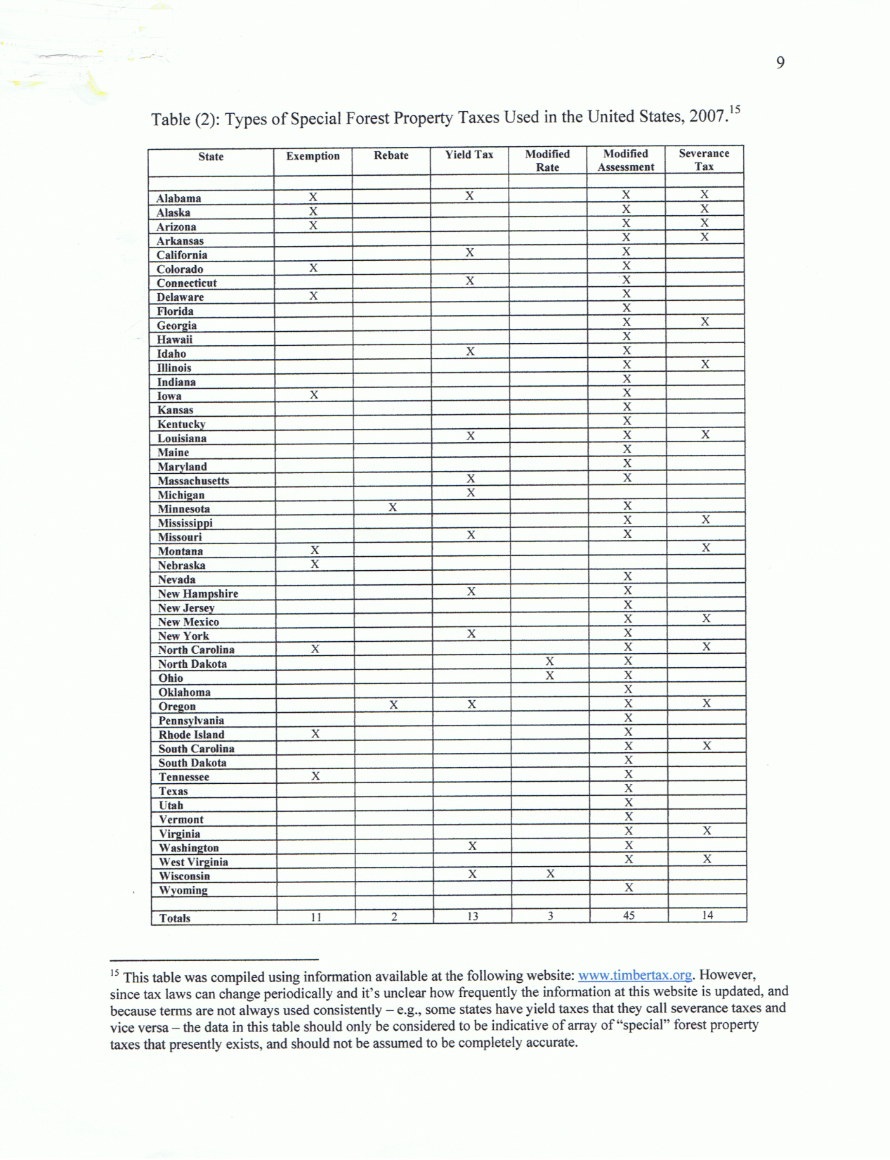
Property Taxes and the Loss of Private Forests
x
NOTE: Eleven states are exempt from woodland owners property tax.
www.timbertax.org/statetaxes/proterty_tax_paper_pdc.pdf

Slide 20
“End Woodland Property Tax”
“. . . let’s take a real leap here. Eleven states including Alaska, Colorado, Nebraska, Montana, North Carolina and Tennessee exempt some private woodlands from property taxes all together. Ohio should join that list. We should take the step that would give our woodlands the best help they could ever have by eliminating property taxes. More land would stay in trees, and more land would go into woods. Future Ohioans would reap the benefits of clean air and water. Wildlife would prosper. Recreational uses would be developed. Economic opportunities for the timber industry would expand.”
“. . . give top priority to woodland preservation.”
Ohio Farmer, Tim White, editor. May, 2015

Slide 21
Percentage of family forest owners and acres of forest land who have a written management plan, who have sought advice, and advice source
OHIO FORESTS 2006 (Published Dec, 2009)
Richard H Widmann, et al
Source of Advice
[categories not exclusive]

Slide 22
David Lytle, Ohio Division of Forestry
PowerPoint: “At a tipping point? The future of Ohio’s forests”

Slide 23
Percentage of family forest owners and acres of forest land by reasons given for owning forest land ranked as very important or important
PERCENT
67 56 65 55 64 63 53 54 41 51 37 47 29 35 28 41 26 35 19 19 13 19 11 9 1 2
OHIO FORESTS 2006 (Published Dec, 2009)
Richard H Widmann, et al

Slide 24
Ohio Private Land Owners
Note: 142,000 Forest Land Owners own 63% (4,996,000 acres) of total (7,918,800 acres) Forest Land in Ohio
[of those who own 10 or more acres]
NUMBER OF LANDOWNERS
24,000
[of total forest landowners]
118,000
194,000
336,000
1,600
[APPROXIMATELY 23% OF ALL FOREST LAND IS OWNED BY FARMERS]

Slide 25
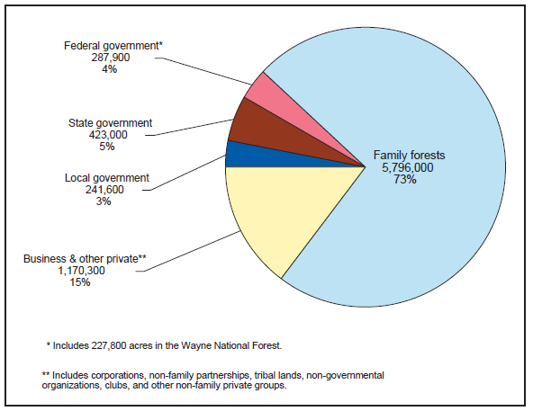
        Ownership of forest land , Ohio Forests 2006
OHIO FORESTS 2006 (Published Dec, 2009)
Richard H Widmann, et al

Slide 26
Ownership of Ohio's Forests
Forest Landowners: Numbers and Acres by Size-class Categories, 2006
Acres Owned | Number of Owners | Total Acres
1-9 | 194,000 | 800,000
10-49 | 118,000 | 2,400,000
50-99 | 15,000 | 1,000,000
100-499 | 8,800 | 1,400,000
500-999 | 100 | 96,000
1,000+ | 100 | 100,000
336,000 5,796,000
OHIO FORESTS 2006 (Published Dec, 2009)
Richard H Widmann, et al

Slide 27
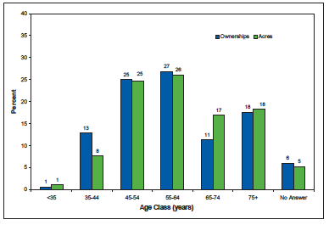
Age of Owner’s and Acres
OWNERS
ACRES
27
26
25 25
PERCENT
17
18 18
13
11
8
6
5
1
1
<35 35-44 45-54 55-64 65-74 75+ No Answer
AGE CLASS (YEARS)
OHIO FORESTS 2006 (Published Dec, 2009)
Richard H Widmann, et al

Slide 28
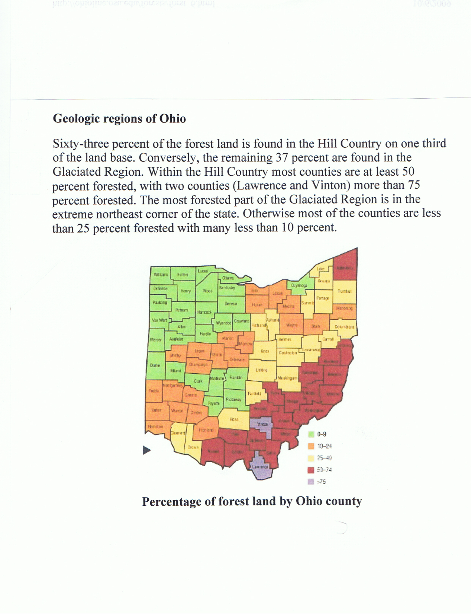
63% Private Woodland is in South Eastern Ohio,
28 Counties
http://ohioline.osu.edu/forests/forst_6.html
ODNR-Division of Forestry
Ohio State University Extension

Slide 29
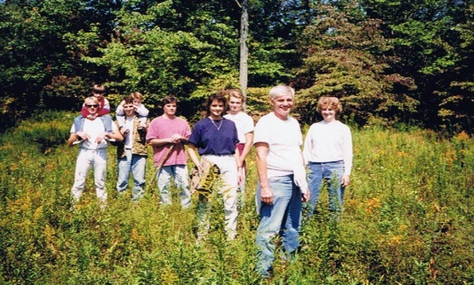
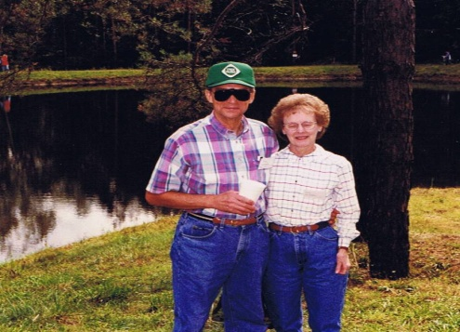
We Need Legislative Support
► Woodland Owners are the largest group of forest landowners in Ohio (73%) but
have the least representation in legislative
actions. Take the next step by eliminating
property tax to help Woodland Owners
promote more forest land for Ohio.

Slide 30

BACKGROUND:
Lack of Incentive to Own
Woodland Owner Priorities
Family
Religion
Children and grandchildren
Work
Health or handicaps
Age
Personal matters
Financial matters ---
then his/her woodland.

Slide 31
We need Laws to Protect Woodland Owners
Woodlands require very few public services.
Cities require a lot of public services.
We should never make “Forced Management Plans” on Woodland Owners.
Ohio Woodlands are not always affordable to manage. We recommend woodland managing on a voluntary basis.
Pine forests in southern states are managed on a 15 to 20 year turn around for profit. Hardwood can take between 60 to 100 years.

Slide 32
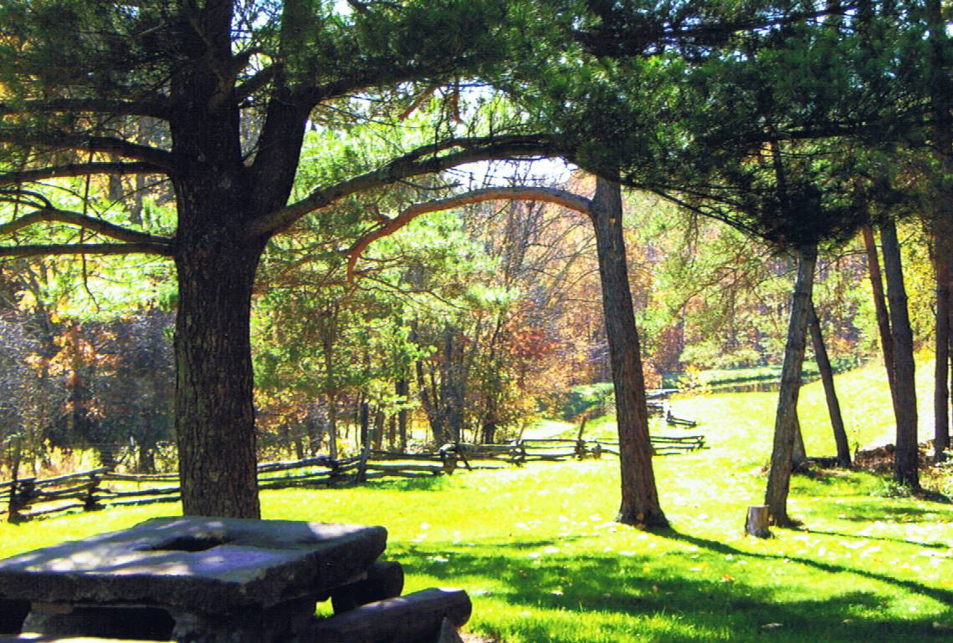

Imagine Ohio going back to 10% forest land. There are 300 to 400 acres of land per day in Ohio that is being developed in
good economic times.
“The US is losing its forest lands to development with potentially undesirable economic, social, and ecological consequences. Property taxes are believed to be relevant to this process both as a cause of, and possible solution to, the problem…”
www.timbertax.org/statetaxes/property_tax_paper_pdc.pdf

Slide 33
Who Divides Up Woodlands?
Investors
Management Companies
Logging Companies
Real Estate Companies
Auction Companies

Slide 34
What This All Means
Managing forest land for certification requirements for
bio-fuels, carbon credits, timber purchases, and
property tax is not cost affordable. Managing fully is
for people who can afford it.
Paying for management plans is costly. We have a plan that Division of Forestry can provide management plans at a no charge service for all woodland owners. We recommend managing forests but only voluntarily.
Woodland owners accomplish a tremendous amount of
good with their trees, water, and soil protection, carbon
dioxide air clean up, wildlife, and recreation.

Slide 35
We need to recognize and compensate woodland owners for all they do by owning and saving our forestland.
We recommend the simplified “Ohio Woodland Owners
Incentive Tax Plan” for all eighty-eight counties in Ohio
with zero tax per acre.
This plan would help all (including the elderly and
handicapped) afford their woodlands, and would
discourage forest fragmentation.
It is worth it to have a “Simplified Woodland Owners Incentive Tax Plan” to save our Ohio Woodlands.

Slide 36
WOODLAND OWNERS RECOMMEND:
“The Ohio Woodland Owners Incentive Tax Plan”
A plan that would apply to ten or more acres of woodlands. Trees may be harvested for timber when appropriate, with Best Management Practices. Further managing would be voluntary on Timber Stand Improvement and Invasive Plants with Educational Programs and Cost Share Programs being available to Woodland Owners. Information and encouragement from the Ohio Division of Forestry (ODOF) is recommended. The recommended tax rate would be no tax per acre.. The Ohio Woodland Owners Incentive Tax Plan would create ways to help woodland owners keep land together at an affordable cost and avoid forest fragmentation.

Slide 37
The Ohio Woodland Owners Incentive Tax Plan recognizes woodland landowners for growing trees; that they provide renewable resources. Woodland property provides: water retention, wood, inhibits soil erosion, wildlife habitat, a source of recreation, and scenery. Trees help to clean the air by taking in carbon dioxide and giving off oxygen.
Service will be provided by Service Foresters, thru the Ohio Division of Forestry to offer help and assistance to woodland owners whenever and wherever possible. Woodland owners shall not be discriminated against by being taken out of woodland programs or county tax reduction programs because of their age, handicaps, health reasons or disabilities. Recognize that any woodland management practice, including timbering affects woods 30 to 50 years from now. Trees take 60 to 100 years to grow in Ohio for wood production.

Slide 38
The Division of Forestry must inform woodland landowners in writing of any changes in laws regarding taxation and woodland management, including logging.
“Qualified” pertains to the process and steps to be able to participate in the Ohio Woodland Owners Incentive Tax Plan. Once a woodland owner successfully completes the Ohio Woodland Owners Incentive Tax Plan Application; pays a one time $25.00 fee; receives the required maps, “Stewardship Guidance Booklet,” information provided by the Ohio Division of Forestry.

Slide 39
The Ohio Woodland Owners Incentive Tax Plan recognizes woodland landowners for growing trees; that they provide renewable resources. Woodland property provides: water retention, wood, inhibits soil erosion, wildlife habitat, a source of recreation, and scenery. Trees help to clean the air by taking in carbon dioxide and giving off oxygen.
Service will be provided by Service Foresters, thru the Ohio Division of Forestry to offer help and assistance to woodland owners whenever and wherever possible. Woodland owners shall not be discriminated against by being taken out of woodland programs or county tax reduction programs because of their age, handicaps, health reasons or disabilities. Recognize that any woodland management practice, including timbering affects woods 30 to 50 years from now. Trees take 60 to 100 years to grow in Ohio for wood production.

Slide 40
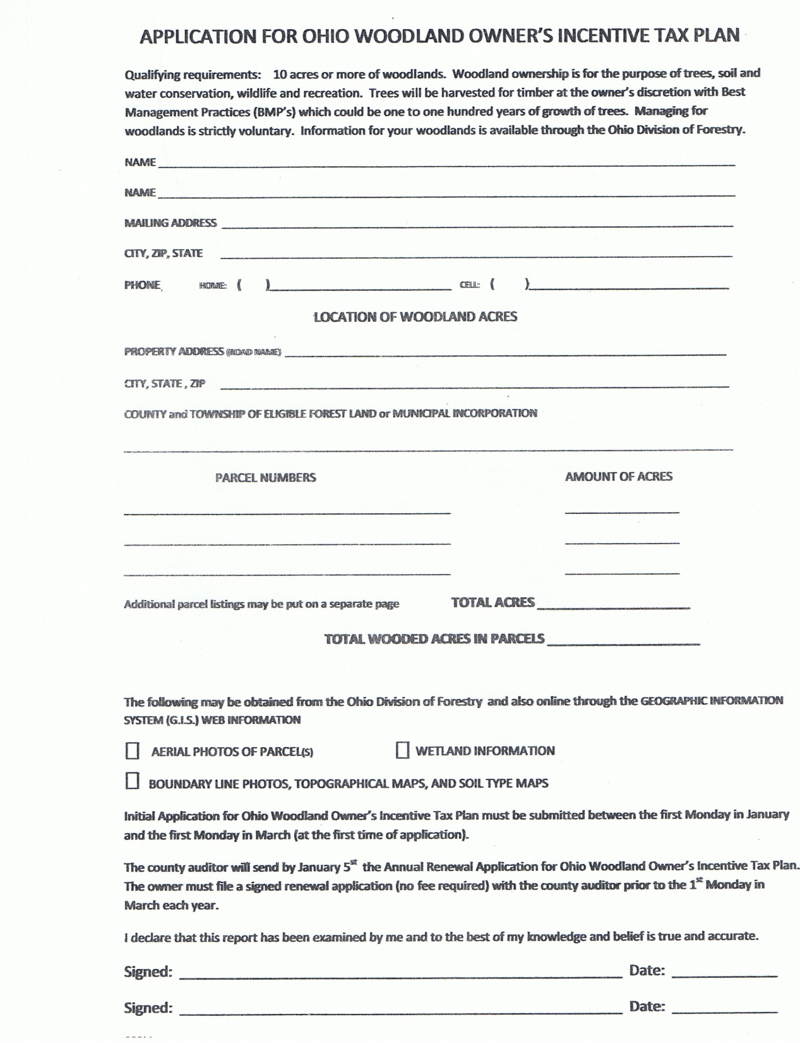
Application for Ohio Woodland Owners Incentive Tax Plan
Simplified Procedure for Woodland Tax Incentive Plan

Slide 41
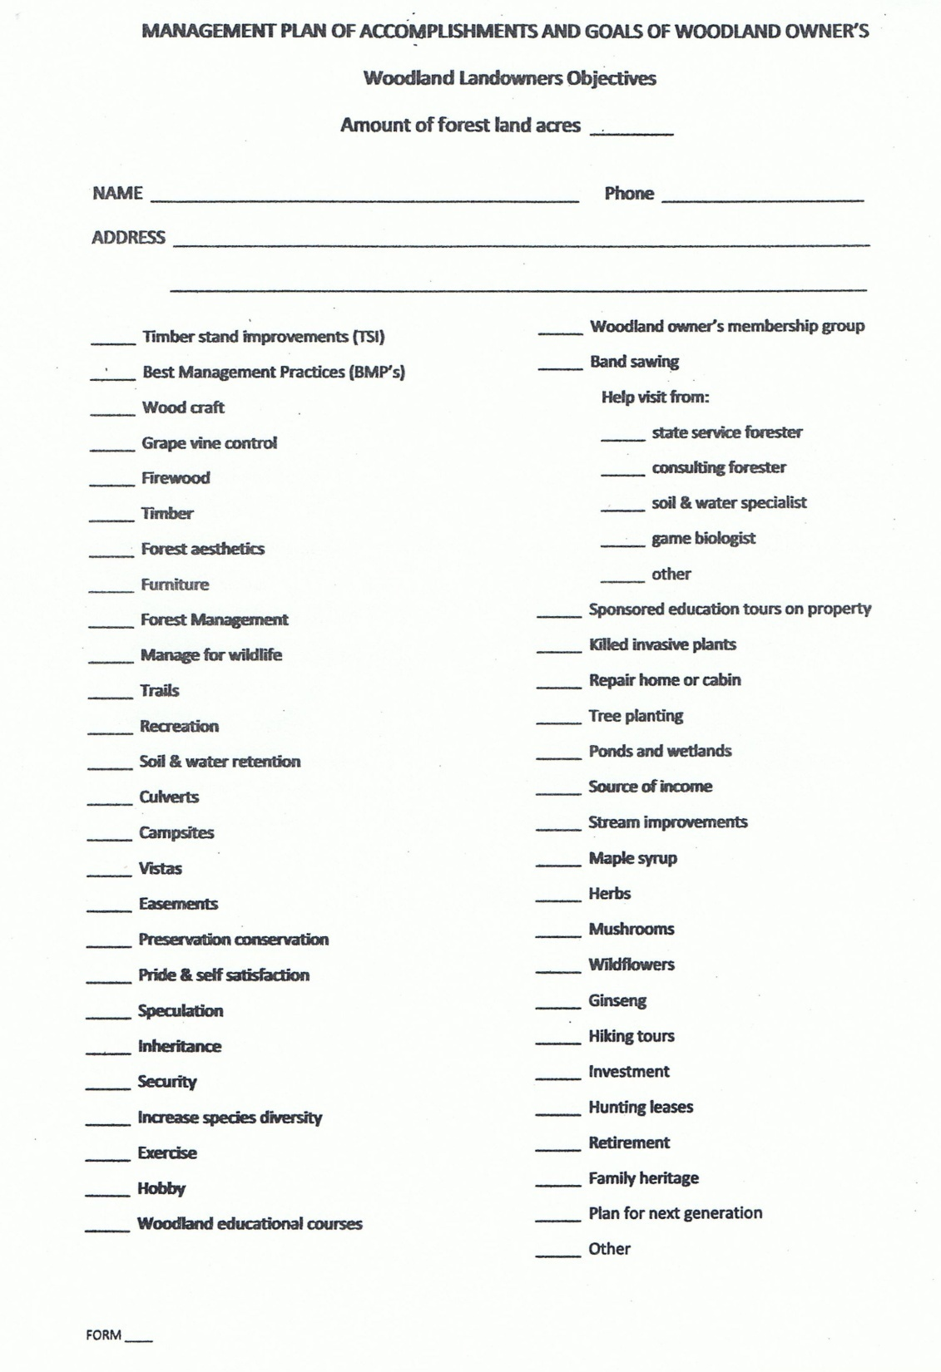
Management Plan of Accomplishment and Goals of Woodland Owners
Woodland Owners Survey
John Smith
7409246789
3200 Jones Dr.
Caldwell, Oh 44678

Slide 42
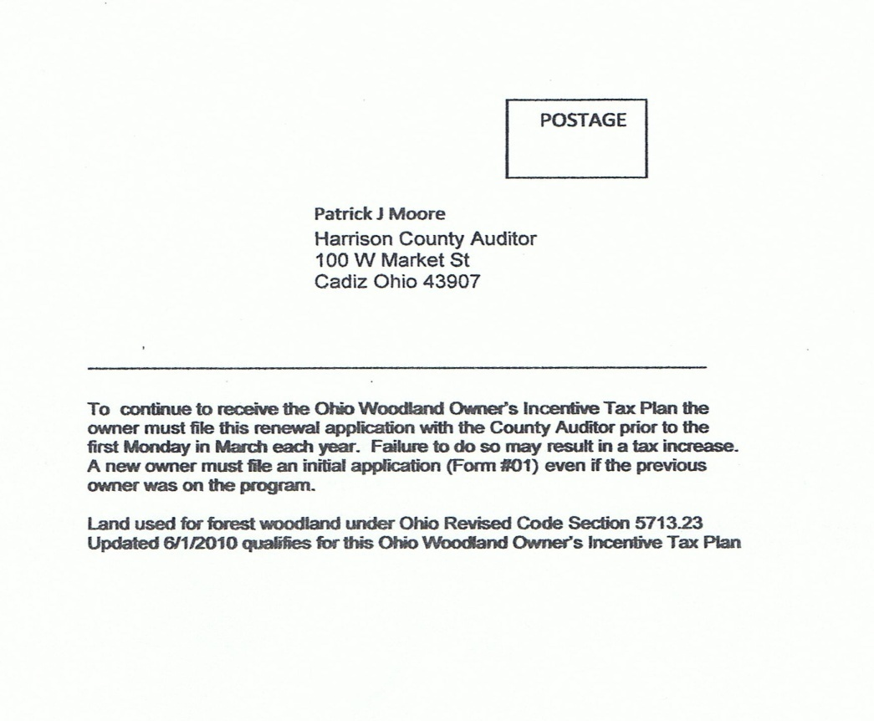
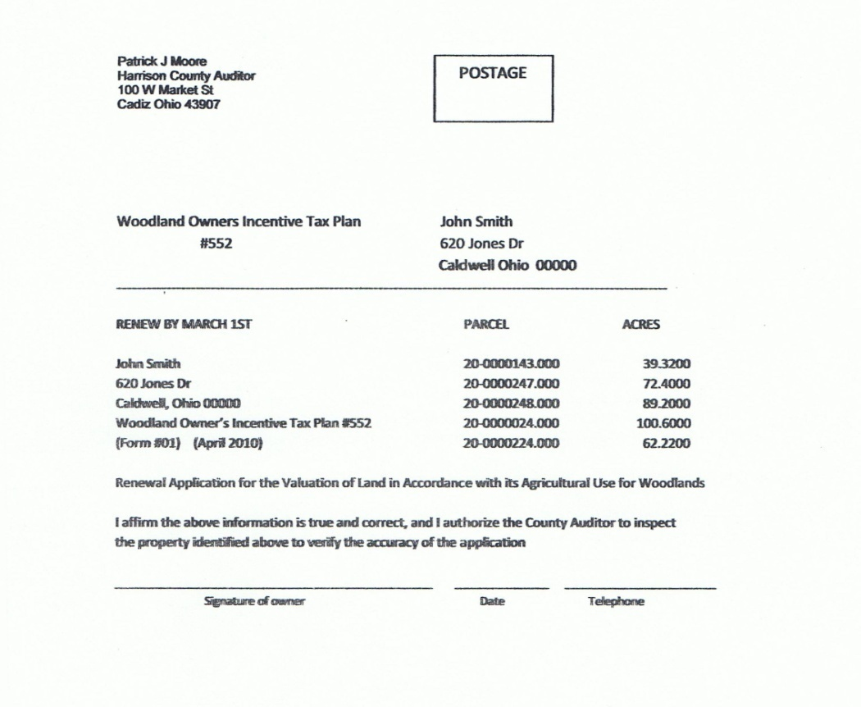

Slide 43

The Division of Forestry as a service to woodland owners provides the Ohio Woodland Owners Management Plan

Slide 44
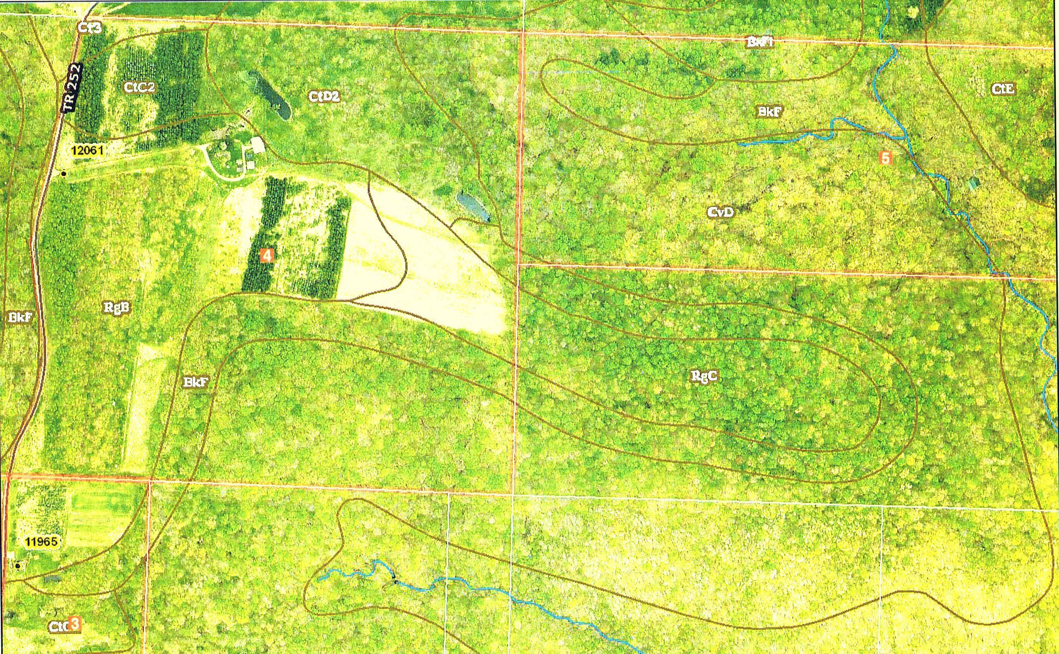
GIS IMAGING
Arial Photo,
Soil types,
Topo Lines,
Boundary Lines,
Streams,
Bodies of water
Trees

Slide 45
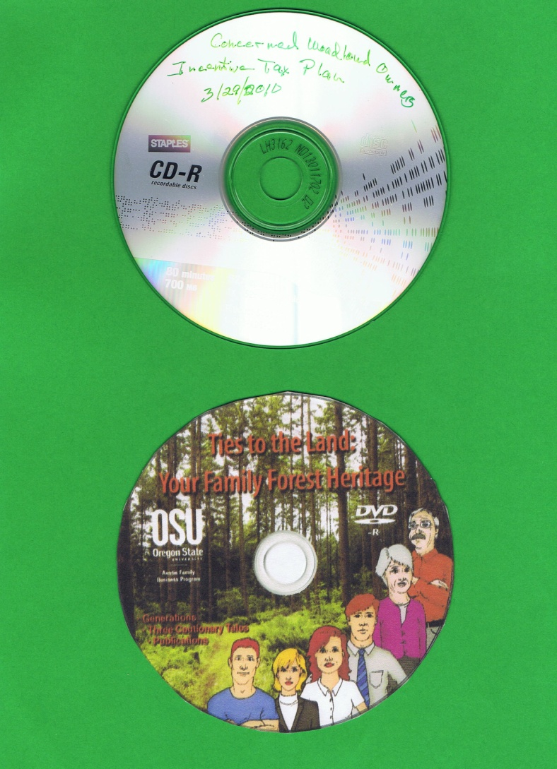
Woodland Owners Educational DVDs on Forest Management and Passing Woodlands to Next Generation

Slide 46
WE INVITE YOU ALL TO DO SOMETHING
GREAT TODAY FOR WOODLAND OWNERS
Set goals in every way to:
Avoid
FRAGMENTATION

Slide 47
We have
Exposed the problems,
Presented the facts,
And come up with the solutions.

Slide 48

The simplified
“WOODLAND OWNERS
INCENTIVE TAX PLAN”
is a program that woodland
owners must have to survive

Slide 49
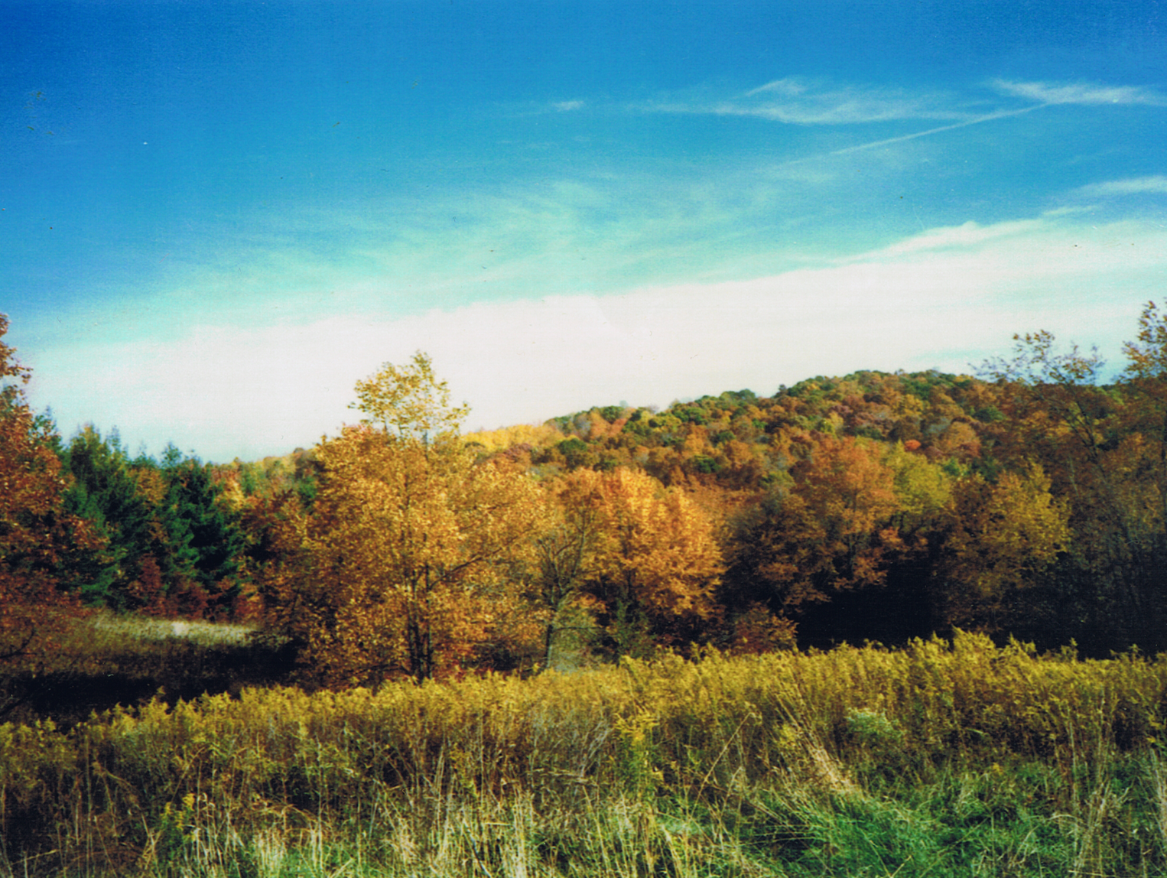
THANK YOU
WOODLAND OWNERS NEED
YOUR SUPPORT!

