Slide 1
Oral Care From Birth to School
Presented by
Barb Ranck, RDH

Slide 2
Starting With Mom
Encourage a healthy diet – eat fresh fruits, vegetables, whole grains and dairy
Encourage regular dental visits – 6 month check-ups, no X-rays, good daily brushing 2X and flossing 1X

Slide 3
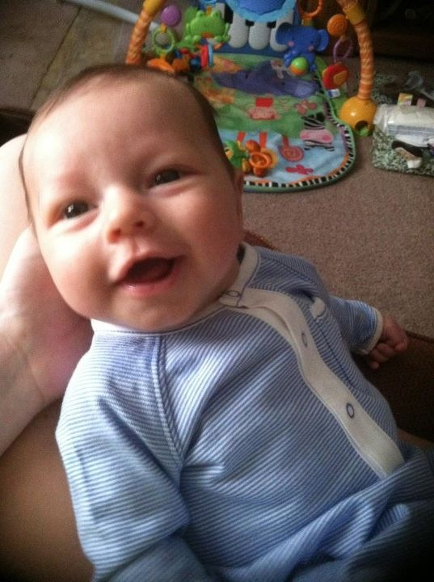
Newborns

Slide 4
When to Begin
When they first come home
During their baths – use a wash cloth, wrap the cloth around your finger, massage the gums
Massaging the gums toughens them and helps with teething

Slide 5
Feeding
Nursing
- Carries are a concern if bottles of breast milk are consistently carried around all day and night

Slide 6
Drinks
Things that are of concern in a bottle:
- Milk
- Juice
- Kool-Aid
- Pop
- Gatorade/Powerade
- All sugary drinks
- THE BEST IN BETWEEN DRINK IS WATER FOR CHILDREN OVER THE AGE OF 1

Slide 7
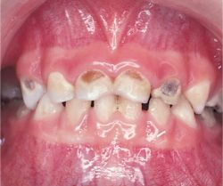

Slide 8
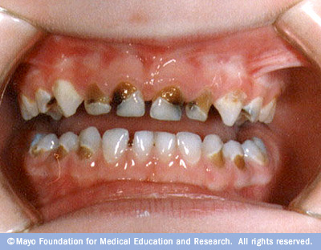

Slide 9
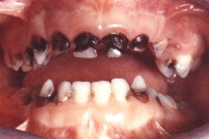

Slide 10
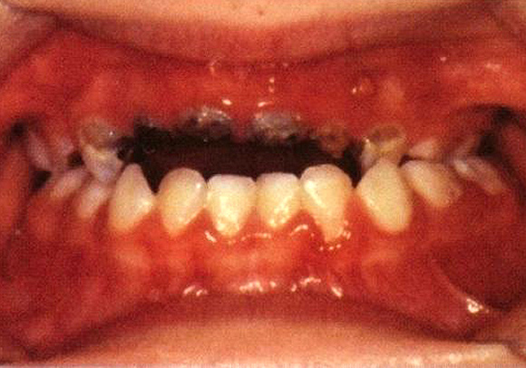

Slide 11
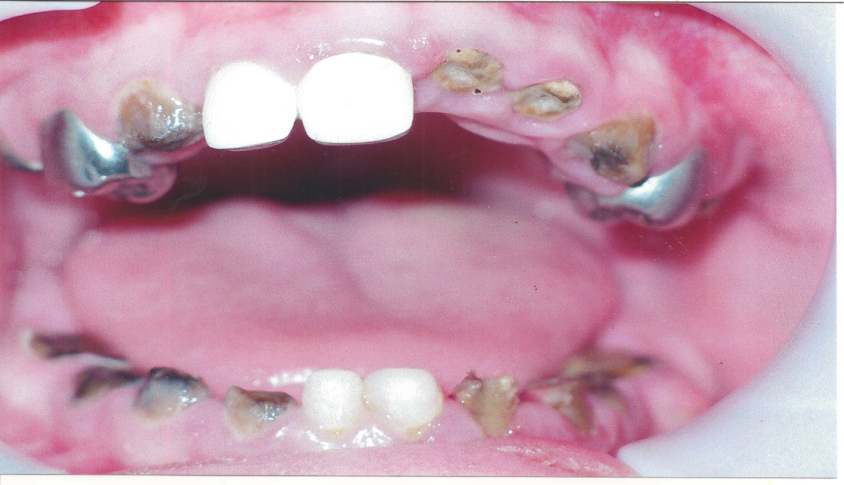

Slide 12
Absolutely no bottles at nap time or at bed time
Hold your baby when feeding then a bottle
Wean your baby off the bottle between 12-18 months
Don’t allow your child to walk around with a sippy cup of sugary drinks for long periods of time

Slide 13
First Tooth
The first tooth usually appears at about 6 months of age
Sometimes it can be as early as 4 months of age
Sometimes it can be as late as 12 months of age

Slide 14
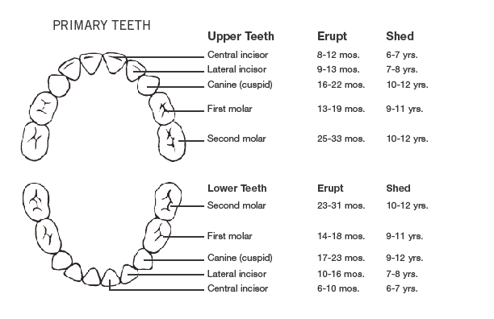
Tooth Eruption Chart

Slide 15
Importance of Primary Teeth
Keeps the space for permanent teeth
Develops clear speech
Helps to shape our face
Unhealthy teeth can harm the permanent teeth
When maintained they help growth

Slide 16
Teething
Possible symptoms:
- Drooling
- Gum swelling/sensitivity
- Irritability/fussiness
- Biting Behavior
- Refusing food
- Sleep problems
Parents may notice loose stools, runny nose, fever

Slide 17
How to Ease Discomfort of Teething
Use a firm rubber teething ring
Cold wash cloth
When old enough give cold foods
Unsweetened teething cracker (Zwieback)
Simply rubbing the gums with a clean finger
Rubbing gums with pain relief gel
If no results, call pediatrician for pain med

Slide 18
First Dental Visit
This visit should be scheduled:
- First tooth
- First birthday
Establish a dental home
- We want this first visit to be kid friendly
- Without pain
- Never tell a child it won’t hurt

Slide 19
The Dentist or Hygienist Will
Have you stay with the child
Examine the teeth to check for decay
Clean the teeth
Possible x-rays
Apply fluoride
Review brushing & flossing
Talk with you to explain what they found & answer your questions

Slide 20
Child’s Diet
Start a healthy diet early
Limit snacks
- Avoid snacks high in fat, calories & sugar, chewy fruit
snacks, sugary cereals
- Give snacks that are low in fat, vegetables, fresh fruits,
cheese, whole grain cereal, yogurt
Swap: pop & juice
For: milk & water

Slide 21
Oral Hygiene Instructions

Slide 22
Oral Hygiene Products
Toothbrush
- We recommend a brush with a small head and a larger
handle for their first brush
- The bristles need to be soft
- Brushes need to be replaced every 3-4 months and
especially after every illness due to bacteria

Slide 23
Oral Hygiene Products cont.
Toothpaste
  - You do not need to use toothpaste when the teeth first come
  in
  - A fluoride toothpaste can be introduced when you begin using
  a toothbrush

Slide 24
Tooth Brushing
Please keep in mind that this can become a struggle at times. You can start out with your child brushing by themselves and then step in. They will probably give you a hard time and fuss with you
But remember you are in charge and you want what is best for them
Handle them in a gentle but firm way. If you start working with them from the beginning, the older they get the easier it can be - but not always
Brush 2 times a day - morning and night

Slide 25
Ways to Help Your Child
From infants to toddlers they will need their parents help, even though they want to do it “Myself”
As an infant you can cradle them in your arm and wash the teeth with the gauze or wash cloth
As they get older you can sit on the floor and have them lay their head in your lap
You can sit on the toilet or chair with them standing on the floor in front of you leaning with their back against you. You would then cradle their head against you

Slide 26
Flossing Techniques
Flossing can be handled very much the same way
However, what I have found best is to floss the child while they are laying in bed
Have the floss in their room, have them get into bed
While they are laying in bed this gives you more stability to floss effectively and quickly
Once you have done that you can have a small cup of water there ready for them. They can swish and swallow then lay down and lights out
Floss at least once a day

