Slide 1
Ohio Infant Mortality: The Dental Connection
Cindy Leverich EFDA, RDH, MSAH

Slide 2
Public Health Crisis in Ohio
Notes:
House Concurrent Resolution (HCR) #12 of the 131st General Assembly, sponsored by Rep. Sarah LaTourette, & Rep. Nickie Antonio, declared Ohio’s rate of infant mortality a public health crisis.
Ohio is ranked among the worst in the nation in infant mortality (46th). Louisiana, Delaware, Alabama & Mississippi are slightly ahead of Ohio.
In 2012, 1047 Ohio babies died before their first birthdays.

Slide 3
Why is this happening ?
Notes:
The leading cause of infant mortality is preterm birth. 6
In Ohio, the preterm birth rate for 2013 was 12.1%. This rate was the same for 2011 & 2012. 6
Overall, in our nation, 400,000 infants are born prematurely each year. This translates into 11% of all live births. 1

Slide 4
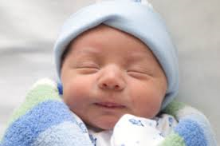
What is a preterm birth?
Notes:
A preterm birth is defined as a delivery that occurs at less then 37 weeks of gestation.
Among babies born before 32 weeks gestation, 89% are admitted to NICUs at an average cost of $280,000.00
Approximately ½ of all congenital neurological disability, including cerebral palsy, are caused by preterm births. 1

Slide 5
Factors associated with preterm births
Maternal smoking/drug use
Low maternal body mass index
Low socioeconomic factors
Maternal Nutrition
Maternal infections
Notes:
The factor that we would like to discuss is maternal infection.
30 to 50% of preterm births are possibly associated with maternal infections such as intrauterine, bacterial vaginosis and periodontitis.

Slide 6
Factors associated with preterm births
Diabetes
African American ancestry
High or Low Maternal Age
Multiply Pregnancies
Hypertension
Notes:
The factors that we would like to discuss is maternal infection.
30 to 50% of preterm births are possibly associated with maternal infections such as intrauterine, bacterial vaginosis and periodontitis.

Slide 7
Percent of Preterm Births
By County, 2010-2012
Preterm births are more likely to occur in Southern Ohio
Notes:
Preterm births are more likely to occur in Southern Ohio.
Geography limits access to dental care

Slide 8
Ohio Counties Above 13.4% Preterm Births
Erie
Cuyahoga
Summit
Allen
Hardin
Marion
Franklin
Montgomery
Hamilton
Adams
Ross
Pike
Scioto
Vinton
Jackson
Lawrence
Meigs
Morgan
Notes:
Lists go from the northeast to the southwest

Slide 9
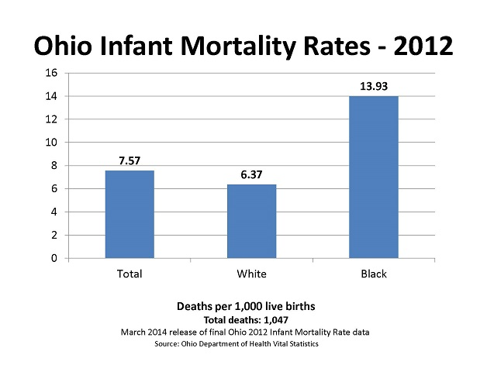
Notes:
Referring back to our second slide with the total infant deaths of 1047, this slide demonstrates the disparity among Caucasians & African Americans. Minorities have larger infant mortality rates in Ohio.

Slide 10
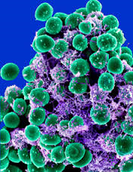
Lets Review
Infection
Bacteria
Immune Responses
Inflammatory Mediators
Preterm labor
Notes:
Lets review why infection is important to our discussion.
Infections are caused by certain types of bacteria.
When bacteria is present in an infection they activate cell-mediated immune responses.
These immune responses lead to the production of inflammatory mediators.
Inflammatory mediators can cause preterm labor if they reach the feto-placental unit.

Slide 11
Inflammatory Mediators: The Culprits
Cytokines
Prostaglandins
Matrix metalloproteinases
Notes:
The inflammatory mediators associated with preterm birth and periodontitis includes cytokines, prostaglandins & matrix metalloproteinases.
Of particular interest is prostaglandins. When prostaglandins activate the inflammatory response and their levels rise, labor can be induced.
Prostaglandins can be used to induce labor.
Also, prostaglandins & the other culprits cause the destruction of periodontal tissues and bone.
It is theorized that the subgingival plaque that contain these inflammatory mediators can travel into the bloodstream and the maternal-fetal interface and contribute to preterm labor.

Slide 12
The Facts
Notes:
In the US, 23% of women age 30 to 54 have periodontitis.
Destructive periodontal disease affects up to 15% of childbearing women, especially low-income and racial & ethnic minorities.
50% of pregnant women suffer from some form of gingivitis or periodontitis. This is caused by increased hormone levels that promote an inflammatory response that can initiate gingivitis or periodontitis.
Periodontal disease is painless so most individuals don’t know they have the disease until there is considerable damage.
The Surgeon General, in 2001, stated that dental & oral disease is a silent epidemic in America.

Slide 13
“However”
Notes:
Association does not mean causation.
However, a pregnant woman or a woman of childbearing age that has an oral disease cannot be considered to be in optimal health.
Also, if oral infections are present, in some situations, the woman cannot get the proper nutrition needed to be healthy prior to pregnancy or during pregnancy.

Slide 14
Notes:
The first relationship between maternal periodontal disease & the delivery of a preterm infant was reported by Offenbacher et al. in 1996. 4
70% of preterm births are spontaneous and there is no identifiable cause. 6
Many studies have been conducted on the relationship between periodontal disease and preterm births with mixed results. The mixed results are attributed to undervaluing the confounding factors such as socioeconomic factors, etc. Also, there have been an inconsistency regarding the definition of periodontal disease and the best format to measure it.
Some researchers utilized only radiographs to determine periodontal disease. This would not allow the researcher to know if the disease was still active.
Duke University studied pregnant women and found that pocket depths & BOP where the best indicators of disease progression.
Bogges et al. reported that women were at a higher risk of pre-eclampsia if they had severe periodontal disease.

Slide 15
“A prime time to reduce the risk of prematurity is prior to pregnancy. The management of chronic health conditions and smoking cessation will reduce risk. Preconception physicals, as well as early prenatal care, can identify women who may need special care before or early in pregnancy.” (2014)

Slide 16
Health Care Providers
Physicians
Obstetricians
Dental Professionals
Dieticians
Midwives
Notes:
Physicians (81%) were aware the pregnancy increased the chance for gingival inflammation however they were not aware that periodontal scaling and root planingwas safe during pregnancy. Only 50% of these practitioners recommend that their pregnant patients visit a dentist during pregnancy.
Obstetricians generally felt that there was an association between poor oral health and adverse pregnancy outcomes. They also considered dental procedures safe including n20 and local administration. However, they did not feel qualified to recognize symptoms of periodontal disease.
Dental professionals (dentists) knew that there was an association between periodontal disease & preterm births. Although they had a high level of knowledge regarding the that poor oral health affected pregnancy they would delay most treatment until the second trimester.

Slide 17
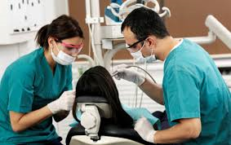
What can we do?
Notes:
Support public policies that stress comprehensive preventative & restorative dental services for vulnerable women such as the continuation of Medicaid and the advancement of the Dental Hygiene Mid-level provider.
Educate women & their health care providers about the importance of oral health prior to and during pregnancy.
Pregnancy is not a reason to defer routine and necessary dental treatment, however the time period between the 14th & 20th week is ideal.

